Slide 1
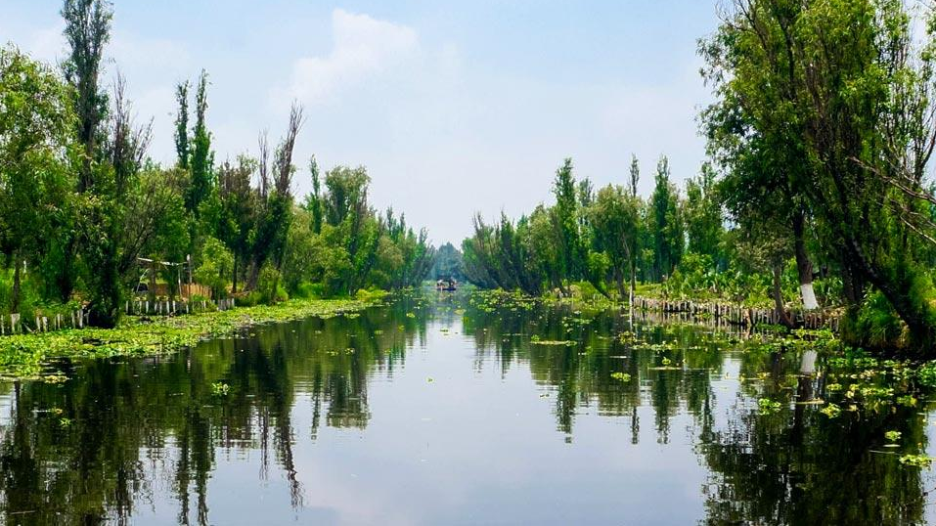
CHINAMPAS

Slide 2
OBJECTIVES:
After this lesson, students will be able to:
Describe what chinampas are and how they work.
Identify the advantages of chinampas-based agriculture.
ASSESSMENTS:
During this lesson, students will:
Learn about the history of chinampas.
Apply what they have learned to build their own chinampa.
Notes:
OVERVIEW:
During this 2-day lesson, students will learn about the ancient Aztec agricultural method using chinampas, specifically focusing on how they are made and what purposes they serve today. Growing food in this way is sustainable and productive, and has had important cultural implications on the societies that succeeded the Aztec Empire.

Slide 3
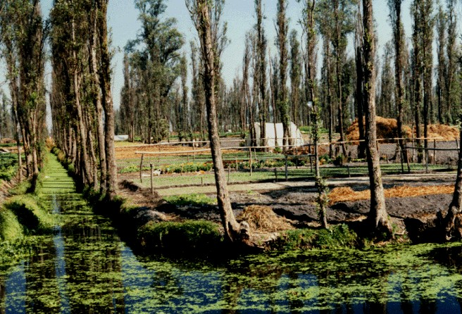
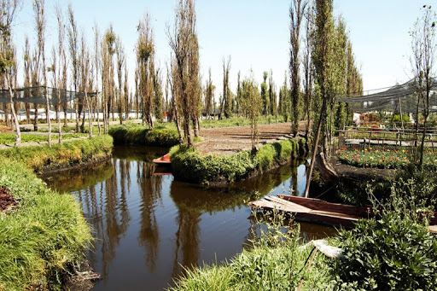
What are chinampas?
A chinampa is a man-made plot of land that “floats” in a body of freshwater.
  They are actually anchored to the bottom of the water (usually a lake).
  They are an ancient agricultural system.
Notes:
Return to the classroom for the lecture portion of the lesson.

Slide 4
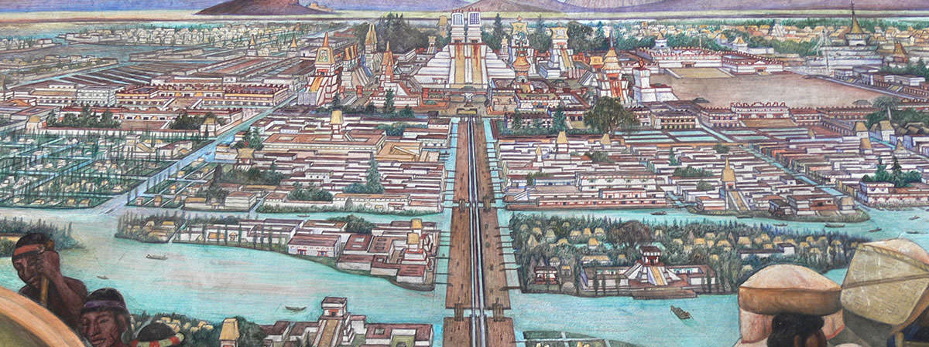
History of Chinampas
Chinampas were created by the Aztecs to grow crops.
  Farmland was limited in the Aztec Empire, so chinampas were ways that they could grow food without taking up more land.
  At the height of the Aztec Empire, there were thousands of chinampas.
Notes:
Chinampas were used by the Aztecs to support their growing population.
The Aztec Empire made up a large part of what is now Mexico during the 15th and 16th centuries.
Their capital was called Tenochtitlan, which was a city in the middle of a lake. Because of the unique location, there wasn’t a lot of room to grow crops. Thus, the chinampas were created.
At the height of the Aztec Empire, thousands of chinampas surrounded the cities.

Slide 5
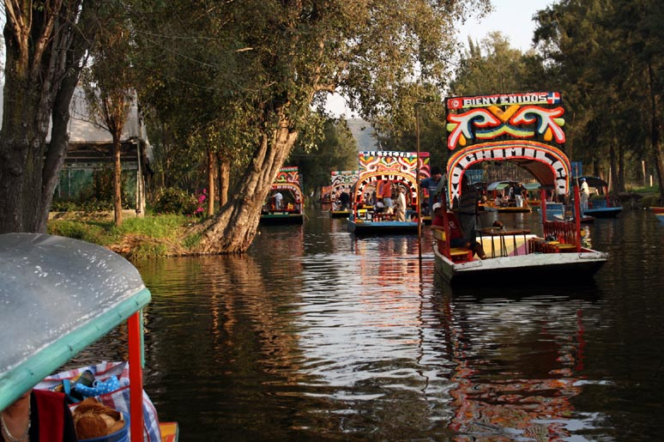
History of Chinampas
Chinampas have retained their cultural importance to this day.
To build a chinampa, one must have knowledge about agriculture, the environment, and the history of chinampas.

Slide 6
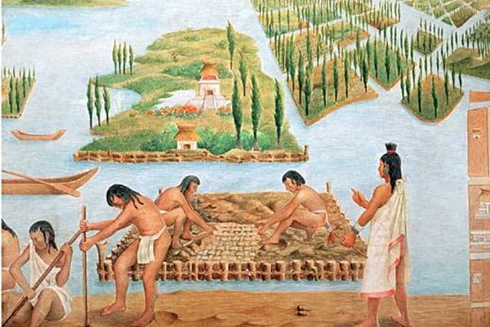
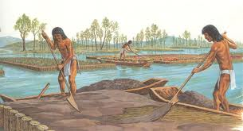
How to Build a Chinampa
Stakes are placed in a shallow part of the water.
Then, a mat is woven out of weeds and sticks that can float on the water’s surface. The mat is tied to the stakes so it is anchored in place.
Mud from the bottom of the lake is added on the mat along with vegetation until the chinampa is above the water’s surface.

Slide 7
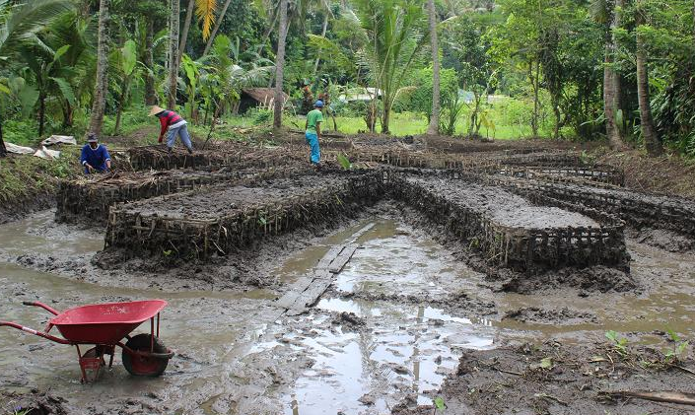
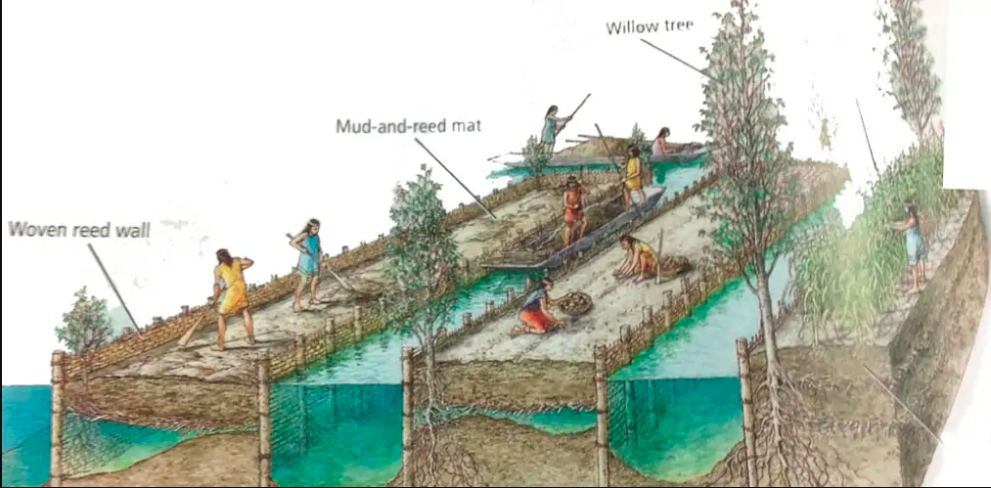
How to Build a Chinampa
Notes:
The mud contains nutrients that will support plant growth. It’s like a natural fertilizer!
Diagram shows how it’s built
Reed wall constructed, then mat built and mud added on top
Over time, created raised plot of land above water’s surface

Slide 8
How to Build a Chinampa
Willow trees are often planted to help anchor the chinampa, but also perform several other functions.
  They serve as fences that keep the soil in place once the stakes rot away.
  They protect the chinampa from harsh wind, pests, and erosion that may occur.
  They also can serve as habitats for birds.

Slide 9
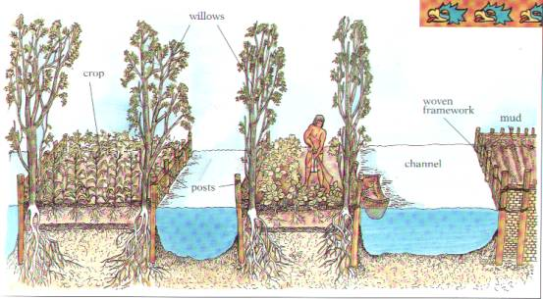
How to Build a Chinampa
Notes:
Diagram shows what chinampa looks like once it’s finished
Willow trees on borders, and crops grown right on top

Slide 10
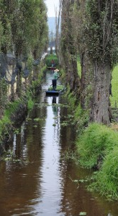
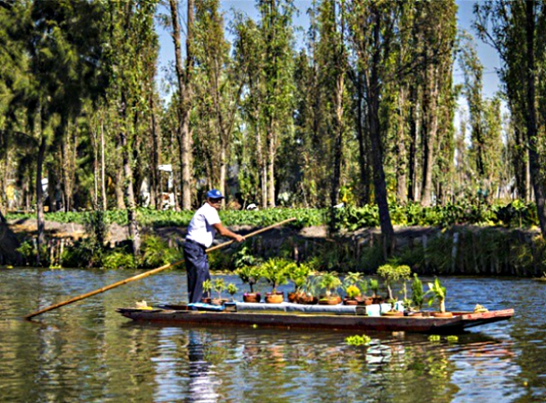
Features of Chinampas
Chinampas are used for gardening, cultivating flowers, and growing crops.
They support biodiversity by providing an environment for plants and aquatic animals (fish and water birds). They can also be used to raise livestock.
The canals between the chinampas serve as both irrigation and waterways.

Slide 11
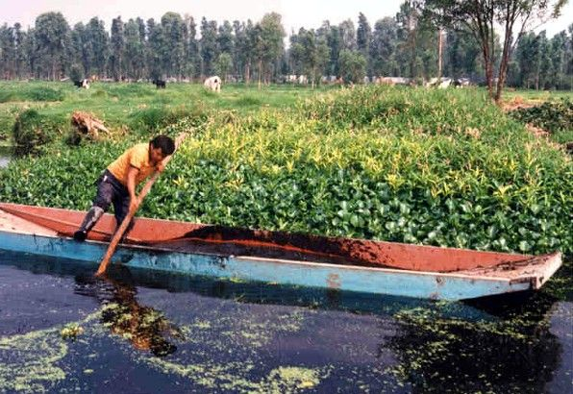
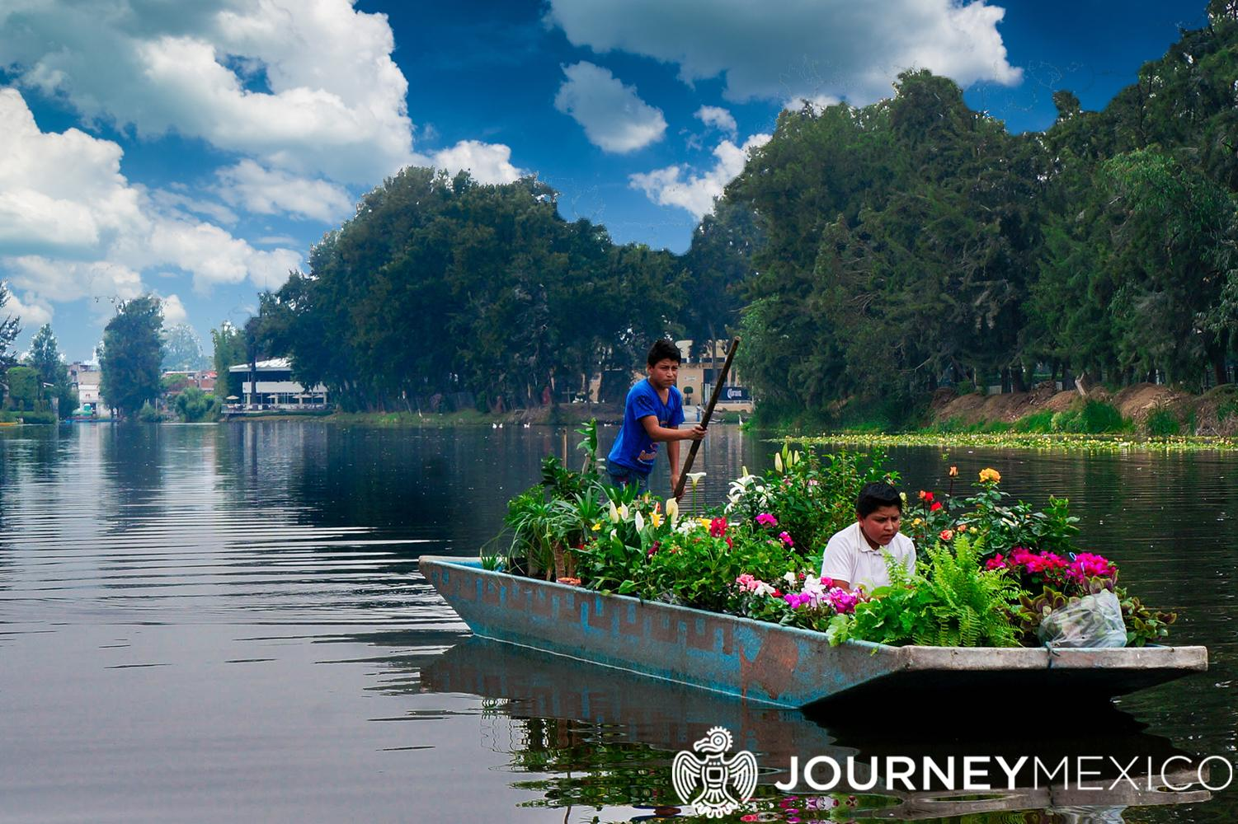
Benefits of Chinampas
Chinampas are agriculturally productive and can grown, on average, five crops per year.
The water is directly delivered to the plants, so less water is used than traditional agricultural methods.
They support biodiversity.
Notes:
Once the plant’s roots are in the water, the chinampa never has to be watered again!

Slide 12
Chinampas Video
https://www.history.com/videos/aztec-ingenuity
Notes:
Watch the video as a summary of chinampas

Slide 13
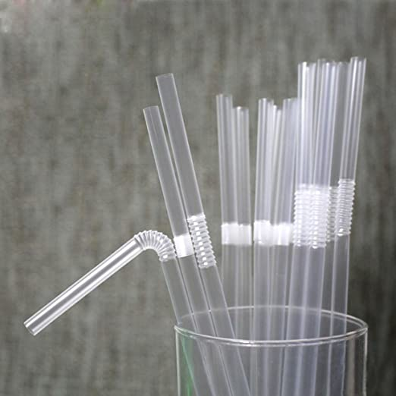
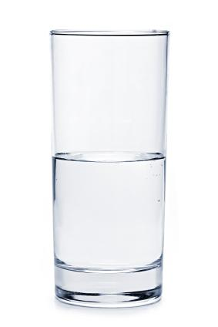
Activity (5 min)
Each group has a clear straw, a pen, and a cup of water.
Notes:
Purpose: Students will be introduced to the idea of capillary action, a scientific phenomenon that allows the vegetation growing on chinampas to be continuously supplied with water.
Break the students up into small groups (can also be done as a whole class activity) with teacher demo.

Slide 14
Activity
Working in groups, complete the following tasks and discuss the following questions:
  Place the straw in the cup of water, having one person hold the straw steady in place.
  Mark the place on the straw where the water in the cup reaches, and mark the place the water inside of the straw reaches.
    What is the difference?
    Why do you think this is happening?
Notes:
Break the students up into small groups (can also be done as a whole class activity) with teacher demo.

Slide 15
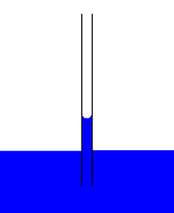
Activity
The water inside of the straw is higher than the water level in the cup due to capillary action.
Water molecules are attracted to the straw, and climb up the sides of the straw.
Water molecules are also attracted to one another.
  As some molecules move up the straw, they pull other water molecules with them.
Notes:
Break the students up into small groups (can also be done as a whole class activity) with teacher demo.

Slide 16
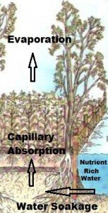
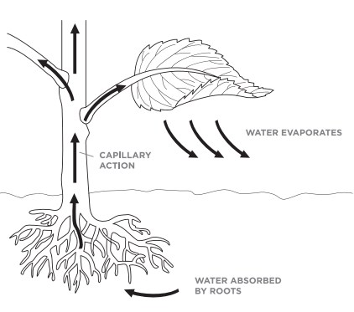
Capillary Action in Chinampas
The water is directly delivered to the plants, so less water is used than traditional agricultural methods.
  As water evaporates from the chinampa surface, it is replaced by capillary action, so water is always available!
Notes:
Once the plant’s roots are in the water, the chinampa never has to be watered again!

Slide 17
~ END OF DAY 1 ~
Next lesson:
  Building your own Chinampa!
  Modern Chinampas
Notes:
Once the plant’s roots are in the water, the chinampa never has to be watered again!

Slide 18
Sources
FAO Report
Aztec History
History.com
History on the Net
Sustainability Times
Ez Gro Garden (Aztec Chinampas of Central America)
Ez Gro Garden (Modern Day Chinampas)
Midwest Permaculture
USGS

