Slide 1
Food Miles

Slide 2
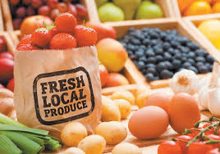
Objectives
Define the term “food miles.”
Evaluate the difference in taste and environmental impact between locally grown food and imported food.
Explain how to determine where food is grown.
Assert why to buy and eat local foods.

Slide 3
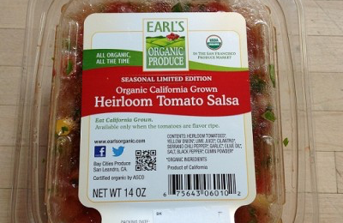
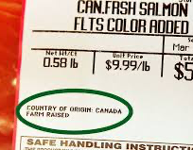
Introduction to Food Miles
Food miles is the distance between where a food is grown and where it is purchased
Country of Origin Labeling (COOL) Law
requires retailers to label produce according to where it’s grown
Many produce shelf cards state where the food comes from
Notes:
COOL law - requires retailers to label meat, fish, fruits, veg, and nuts; provides consumers with info about the source of their food and allows for transparency
shelf cards - say the name and price of the food
ex - California Fresh

Slide 4
Locally Grown
Locally grown means the food is grown close to where it’s sold
Eating local also means eating seasonally
Local food is harvested when it’s ripe
When food has many food miles, it’s picked before it’s ripe
This way, it’s ready by the time it arrives at the destination
Food picked too early tastes different
It’s harder to eat local in different places
Notes:
harvested when ripe bc doesn’t have to travel far to reach its destination
when food has to travel a long distance, it may take days or weeks to arrive at its destination. so, it’s picked before it is ripe so by the time it arrives it is ready to eat.
picked too early tastes different, decline in taste and nutrient values
in CA, we’re lucky that we have a large agricultural industry so lots of food is grown here and it’s easier to eat local.
states like north dakota or montana don’t grow as much food so it’s harder to eat local

Slide 5
Environmental Impact
Long distance transportation of food burns fossil fuels and releases CO2
Faster methods of transportation release greater quantities
Why is CO2 bad?
Increases the global temperature
Leads to melting of sea ice
Increases pollution and natural disasters

Slide 6
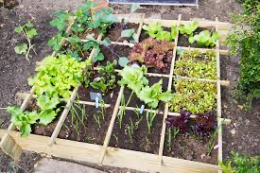
What can you do?
The environmental impact of food miles can be reduced
Buy local produce
Check labels
Farmers Markets
Eat seasonal produce
Grow your own food and have a garden
Notes:
produce in season is more likely to be local

Slide 7
Video
https://www.youtube.com/watch?v=b7rn5hH5XN8
What are your thoughts on the video?

Slide 8
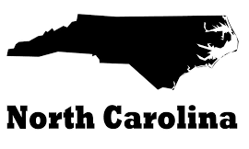
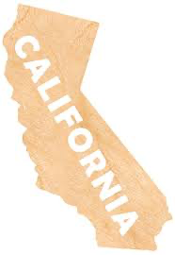
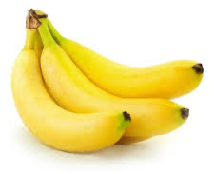
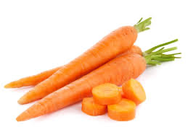
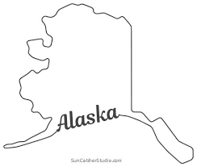
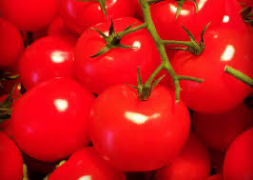
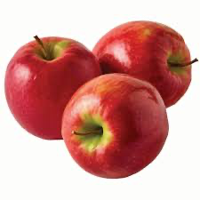
Debate
Each person picks a food and a place.
Decide whether you’re arguing for or against long distance transportation.
Notes:
would do as a debate but just going to do as a discussion right now.
everyone pick a food and a place and decide for or against.
take a few minutes and come up with a few points for an argument, then we’ll discuss

Slide 9
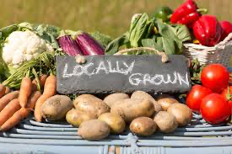
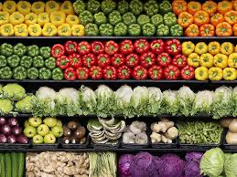
Snack
Serve organic produce in season from the garden
Serve organic produce not in season from another state
Can you taste a difference?
Notes:
the idea is serving …
hoping for feedback in this section, paula and i were discussing logistics and i wanted other’s thoughts

Slide 10
Sources
Center for Urban Education about Sustainable Agriculture
https://cuesa.org/learn/how-far-does-your-food-travel-get-your-plate
USDA
https://www.ams.usda.gov/rules-regulations/cool
This lesson was developed by Kasey Hegelein, a UCLA intern. To contact her, please email kasey.hegelein@gmail.com

