Slide 1
Greenhouse Gases
What’s the deal?
Notes:
Ask rhetorically→ So what’s the deal with greenhouse gases?

Slide 2
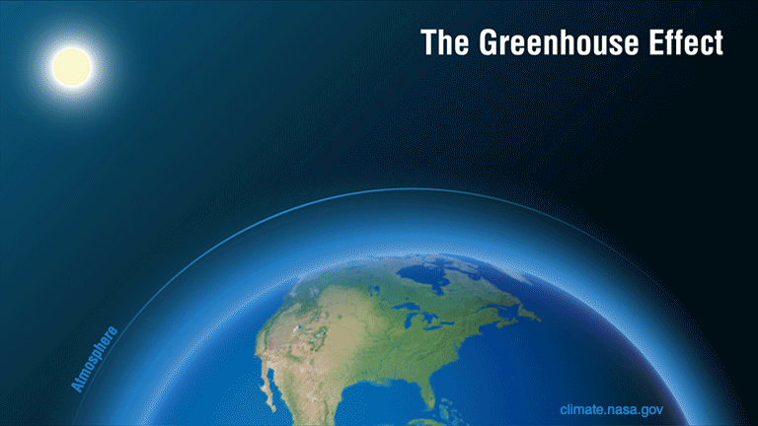
What are greenhouse gases?
Gases that interact with the Sun’s energy by absorbing it and then spitting it out back at the Earth.
They cause the greenhouse effect by trapping heat near the surface of our Earth.
Notes:
Use image to help explain by reading out the captions as they come and pointing to the heat (red arrows) being trapped.

Slide 3
Greenhouse gas examples
Carbon Dioxide:
cars using fossil fuels
Methane:
cows and rice farms
Ozone:
exhaust from factories and cars
Nitrous Oxide:
fertilizers used in agriculture
And where do they come from?
Notes:
Students may have heard of the “Ozone Hole”. If they ask, explain: this ozone has a different role than greenhouse ozone. Though it has the same chemical makeup, it is located much higher in the atmosphere and protects us from the Sun’s harmful UV rays. In this part of our atmosphere, ozone acts as a greenhouse gas. Otherwise, don’t worry about it, no use in confusing them.

Slide 4
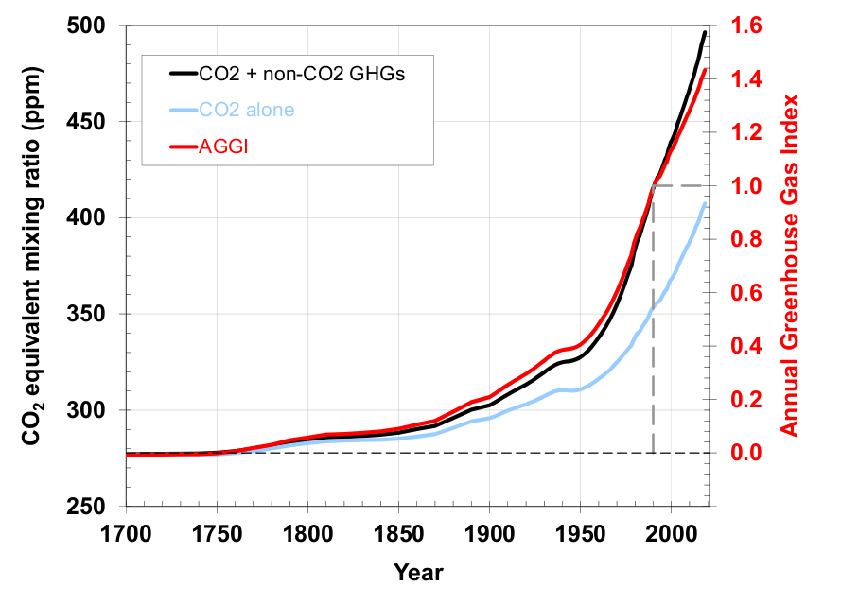
What’s going on?
In the past century and half, we have been producing far more greenhouse gases than our Earth is used to.
This is causing the Earth to heat up much faster than it ever has before.
Notes:
ask students→ what year did the greenhouse gases start to increase faster?
Answer: ~1800 Explain→ this is when the Industrial Revolution occurred and humans starting building machines that use fossil fuels, specifically coal

Slide 5
Why is this bad for us?
Notes:
ask students→ does anyone have any ideas why warming our atmosphere too quickly would be bad for us? (this will be answered with the following slides)

Slide 6
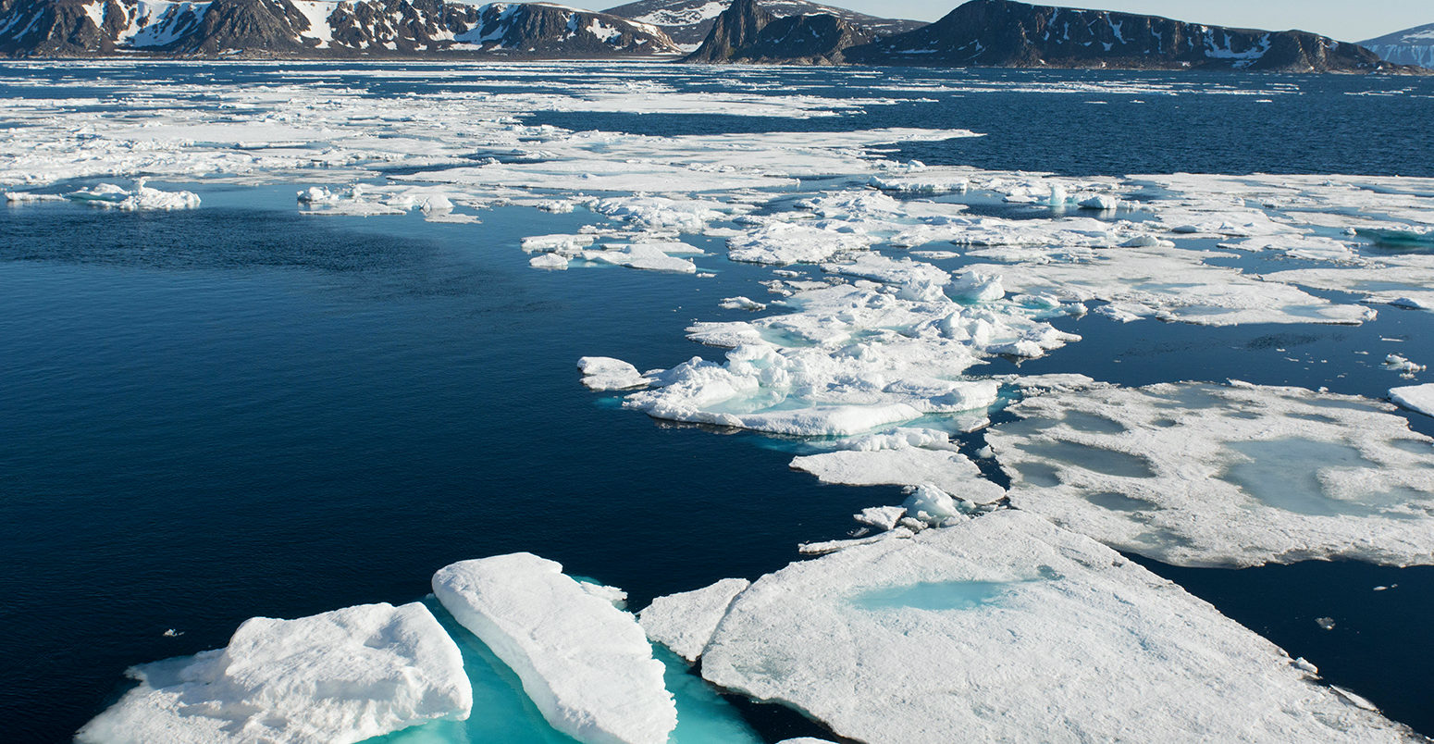
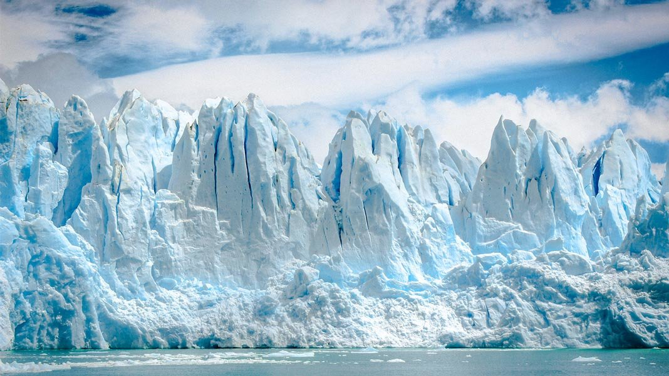
Answer: Many Reasons!
Sea Ice Melting
White sea ice reflects sunlight, so it doesn’t get too hot. When it melts, sunlight is absorbed by the ocean and our atmosphere heats even faster melting more ice.
The homes of polar bears, seals, and other arctic animals are going away
The sea levels are rising, coastal cities, like Venice-MarVista, will be underwater.
Notes:
Give example of (1a) → when you wear a black tshirt, you feel hotter than when you wear white because the black absorbs more sunlight than white. Use first picture to point out color difference.
Explain for (1c) → when you see glaciers, that is ice that is not in the water. When the ice melts, it creates more water, making more ocean water. Use second picture to point out the ice not in the water.

Slide 7
Answer: Many Reasons!
Climate change
Hotter temperatures
Big and dangerous storms
Super dry seasons, fires

Slide 8
Answer: Many Reasons!
Farming
We won’t be able to grow many fruits and vegetables that die in warmer temperatures
Fruits: pears, apricots, cherries
Vegetables: lettuce, broccoli, peas, brussel sprouts
It will be too dry, so we will need to use more water
Notes:
In Southern California, we would be able to grow these fruits anymore, they would have to be grown in northern states like Washington. Our fruits and vegetables wouldn’t be as fresh if they have to travel hundreds of miles to get to us.

Slide 9
Check out the Difference!
Notes:
Explain→ This is Los Angeles before and during quarantine. The haze you see in the first picture is the greenhouse gas, ozone, in the air.
Ask→ Why do you think there were less greenhouse gases in the air during quarantine?
Answer: Since everyone was staying at home, there were a lot less cars to create the gases. Mention slide 3→ Remember that earlier we said that ozone, one of the greenhouse gases, is created by cars.
Ask→ How long was quarantine? Emphasize→ In such a just a few months, we significantly reduced greenhouse gases. Imagine what difference we would make if we kept trying to reduce gases.

Slide 10
Let’s get one thing straight!
Weather: changes in our atmosphere over short periods of time.
Days, weeks, a month
Climate: changes in our atmosphere over long periods of time
Many months, years, decades
Climate vs Weather

Slide 11
Think about it this way...
Weather tells you what to wear today, but climate tells you what clothes you need in your closet.
Notes:
say→ so if it’s really hot one day, you can’t say “it’s climate change” because you are only describing the weather for that particular day

Slide 12
Know the difference...
Los Angeles is very hot today.
The average temperature at Venice Beach has increased in the last ten years.
Mar Vista has been colder than usual this past week.
In the previous decade, the temperature of Los Angeles of increased by five degrees.
Climate or Weather?
Notes:
read the slide aloud and ask for each sentence→ is this an example of climate or weather?
Answers: weather, climate, weather, climate.

Slide 13
Know the difference...
Los Angeles is very hot today.
The average temperature at Venice Beach has increased in the last ten years.
Mar Vista has been colder than usual this past week.
In the previous decade, the temperature of Los Angeles of increased by five degrees.
Climate or Weather?
Notes:
Use the underlined words to emphasize that short amounts of time mean weather and long amounts of time mean climate.

Slide 14
What did we see?
What happened to the “heat” when it was tagged by the “greenhouse gas”?
How does the heat being trapped affect our environment?
What changed after there were more or less “greenhouse gases” in the atmosphere?
Recalling from before, what causes greenhouse gases to build up in our atmosphere?
Notes:
Answers:
They were trapped
Slides 6-8
More: more heat was trapped
Less: less heat was trapped
This shows us how the amount of greenhouse gases in the atmosphere affect our climate
4. Slide 3

Slide 15
How can we reduce greenhouse gases?

Slide 16
We will answer this question tomorrow!

