Slide 1
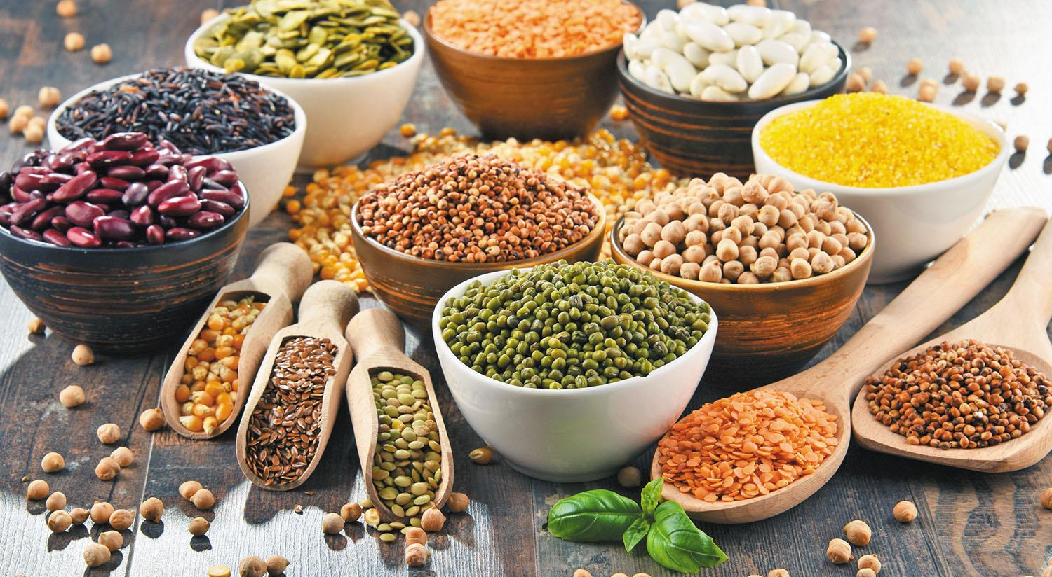
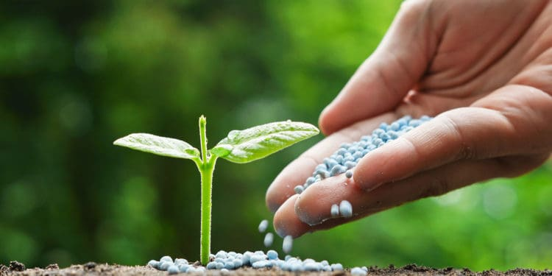
Nitrogen Fixation & Legumes
Notes:
OVERVIEW:
Students will learn that nitrogen is an essential nutrient to all living things. However, atmospheric nitrogen must first be converted by bacteria in the soil into a form that plants can use. In legumes, a symbiotic relationship emerges between the nitrogen-fixing bacteria and the plants.

Slide 2
OBJECTIVES:
After this lesson, students will be able to:
Identify nitrogen as an essential nutrient for plant growth.
Explain in general terms how nitrogen from the atmosphere is converted into a form the plant can use.
ASSESSMENTS:
During this lesson, students will:
Further their understanding of nitrogen fixation.
Compare the roots of legumes and non-leguminous plants.

Slide 3
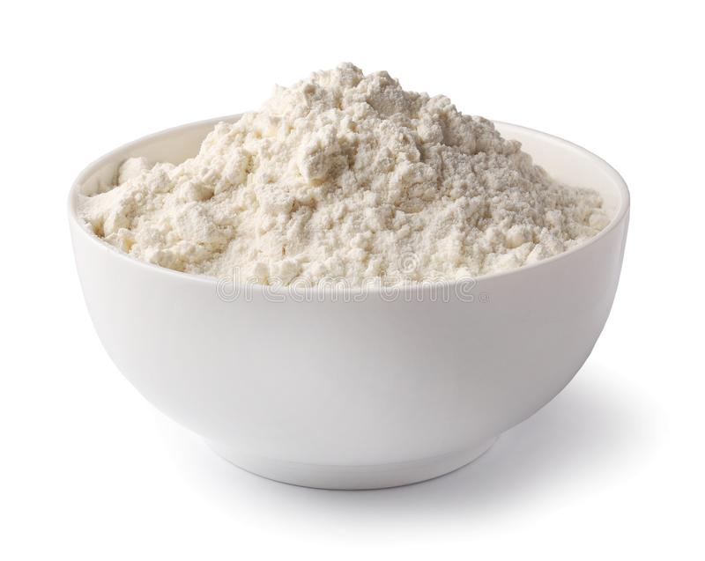
Warm-Up (5 min)
Each group has a water bottle full of dirty water and a small bag of flour.
Notes:
Split students into groups and give each group a water bottle full of dirty water and a small bag of flour (can also use coffee beans or some other raw ingredient that is inedible)

Slide 4
Warm-Up (5 min)
What is essential for humans? What do we need to survive?
Water, food, air.
Each group will have 3 minutes to answer the following questions:
If we need water to survive, why can’t we drink the dirty water?
If we need food, why can’t we just eat the flour?
Come up with different ways to make the water and flour useful to us, either together or separately.

Slide 5
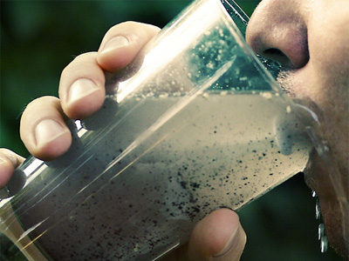
Discussion
If we need water to survive, why can’t we drink the dirty water?
The dirt in the water would make the water hard to drink, and could make us sick.
If we need food, why can’t we just eat the flour?
Flour on its own is just ground wheat and can be dangerous to consume when raw because there are still bacteria in it.

Slide 6
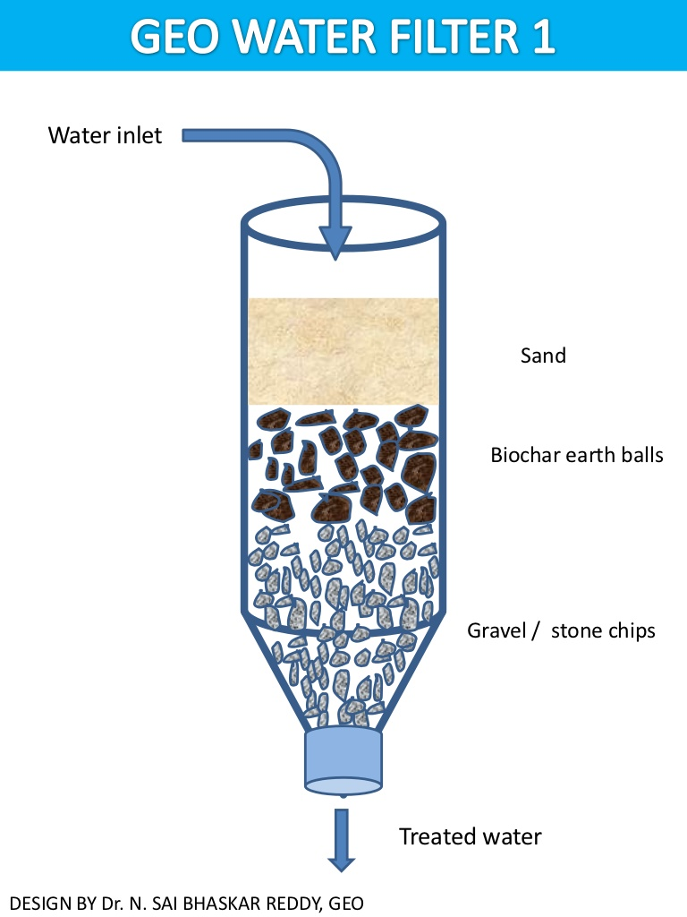
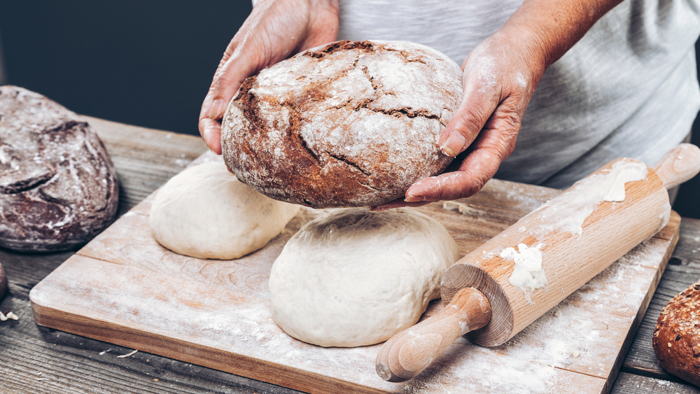
Discussion
3. Come up with different ways to make the water and flour useful to us, either
together or separately.
You would have to purify the water by passing it through a filter and boil it to ensure all the germs and dirt are removed.
You would have to make the flour into another food, like bread.

Slide 7
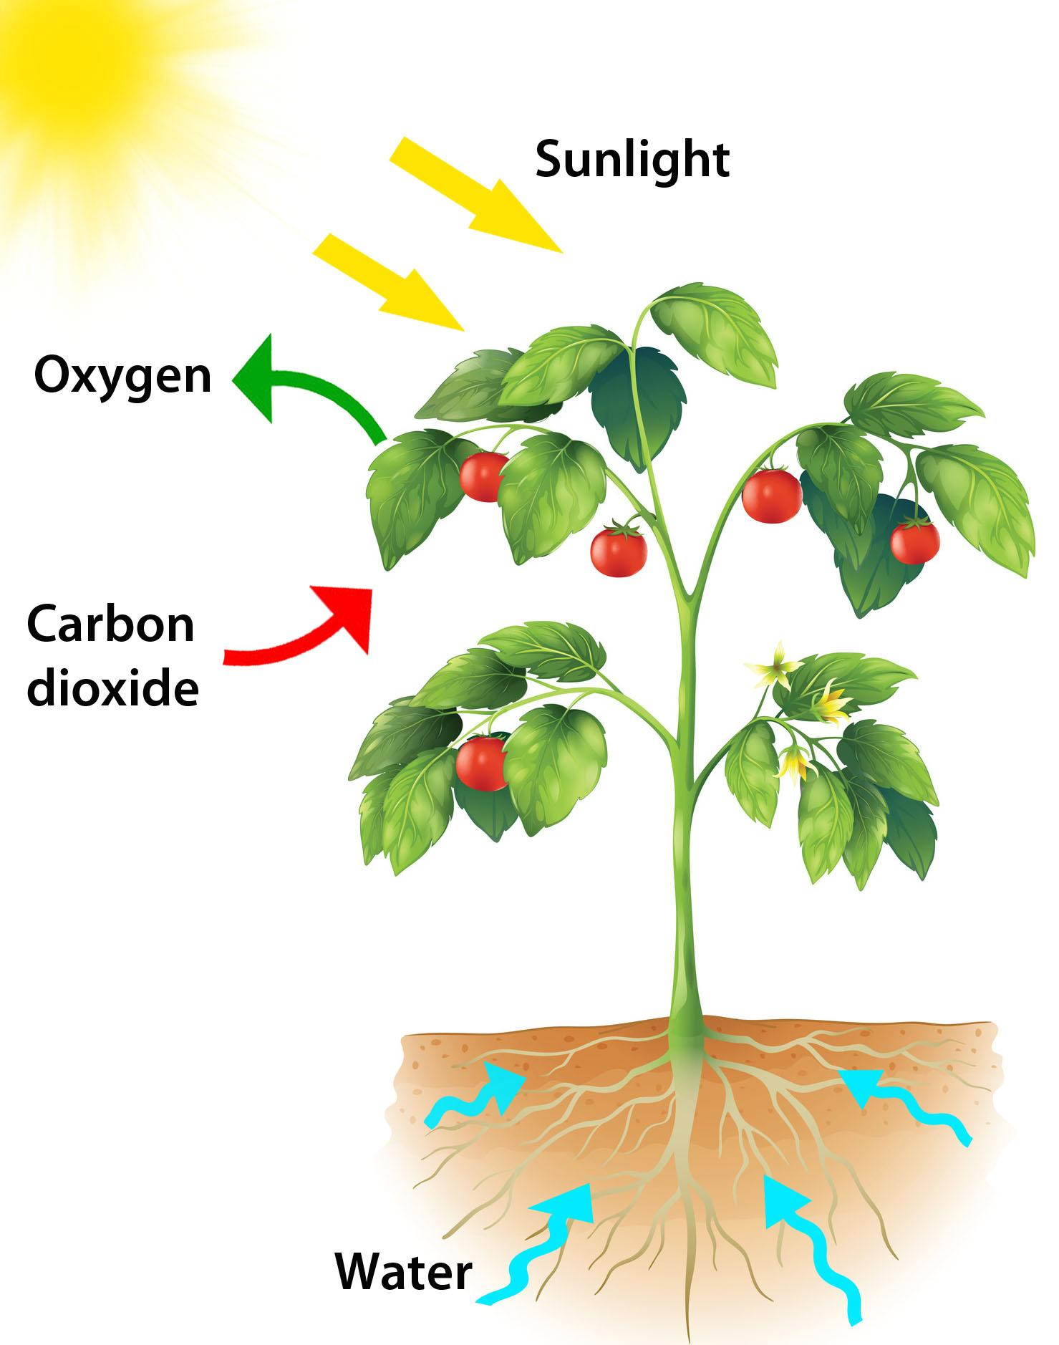
Discussion
Just like we need to change the water and flour to be useful to us, plants need to take sources of food and make them useful before they can absorb them.

Slide 8
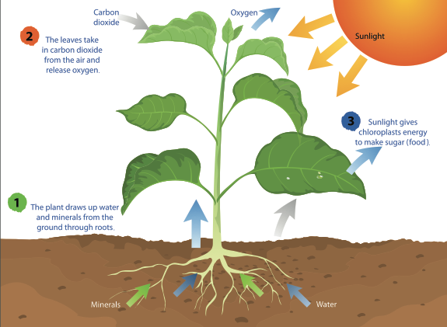
Garden Activities (15 min)
How do plants get nutrients?
Leaves allow plants to take in sunlight and carbon dioxide.
The stem contains veins that transport nutrients throughout the plant.
The roots absorb water and other nutrients from the soil.
https://ssec.si.edu/stemvisions-blog/what-photosynthesis
Notes:
Garden Activities portion can serve as notes for teacher in garden (bring laptop) or can be given as presentation in classroom
Divide into groups and go out in the garden with an adult leading each group.

Slide 9
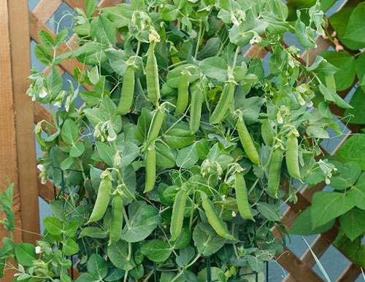
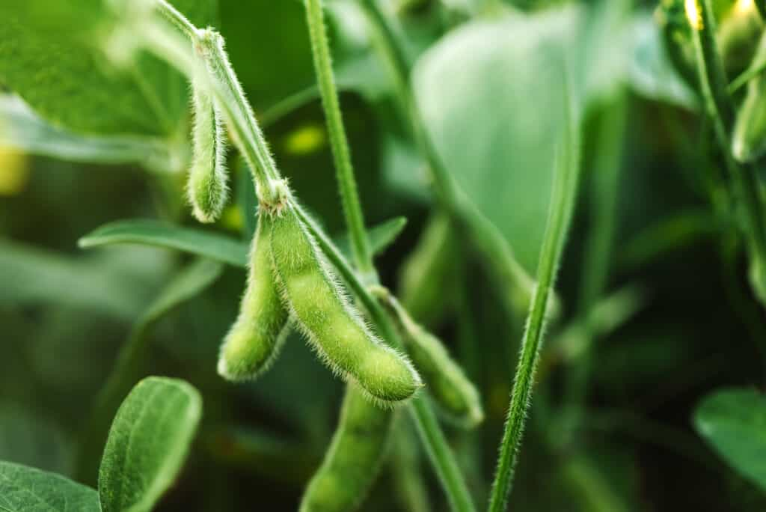
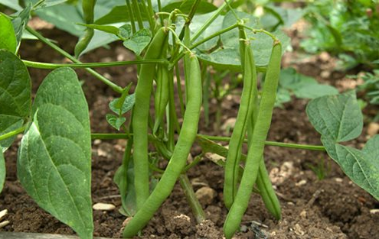
Garden Activities: Legumes
Name and identify legumes in the garden! Record observations of what the plants look like.
Notes:
Left to right: peas, soybeans, green beans
These are just some examples that the students could point out

Slide 10
Garden Activities: Legumes
What are some features of legumes?
https://www.istockphoto.com/vector/legume-plants-set-of-vector-illustrations-gm953629238-260338210
Notes:
All have pods of some sort
Some have flowers
Varieties of leaves

Slide 11
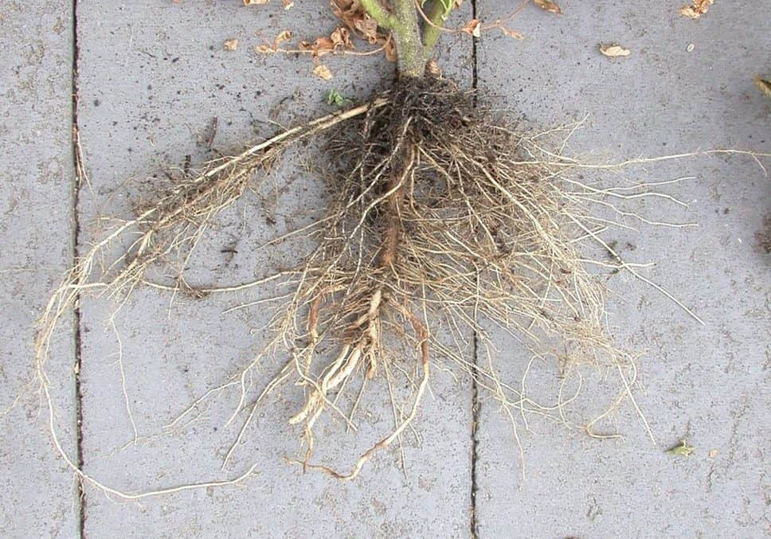
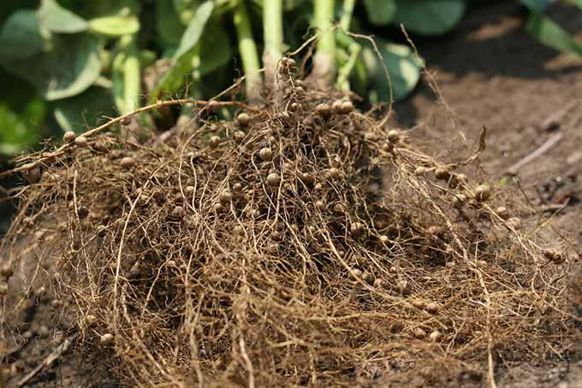
Garden Activities: Legumes vs. Non-Legumes
Now, we’re going to dig up different plants and compare the roots.
Tomato
Pea Plant

Slide 12
Garden Activities: Legumes vs. Non-Legumes
Do you notice the little bumps on the roots of the legumes? What do you think these are?

Slide 13
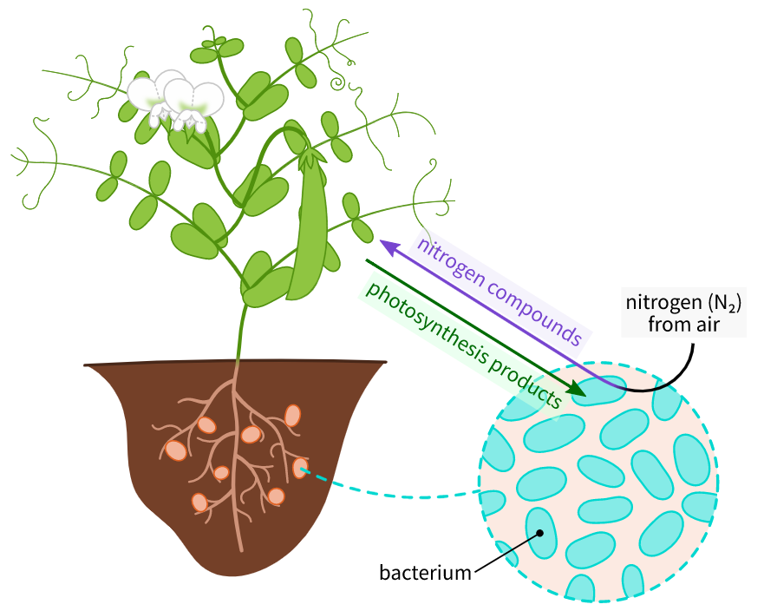
Root Nodules
Do you notice the little bumps on the roots of the legumes? What do you think these are?
They are called root nodules and contain a bacteria that converts nitrogen gas from the atmosphere into a form the plant can take up as a food.
This process is called nitrogen fixation.
Legumes are excellent sources of nitrogen because of these root nodules and the bacteria inside of them!
https://en.wikipedia.org/wiki/Root_nodule#/media/File:Nitrogen_fixation_Fabaceae_en.svg

Slide 14
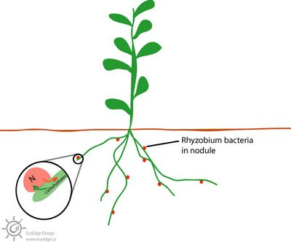
Remember symbiosis?
In return for the nitrogen, the plant provides protection and nutrients to the bacteria.
When both organisms benefit in a relationship, it is called symbiosis!
This is like if you gave the flour to a baker and paid him for the bread he made with it.
Notes:
Recall: Nitrogen Cycle lesson

Slide 15
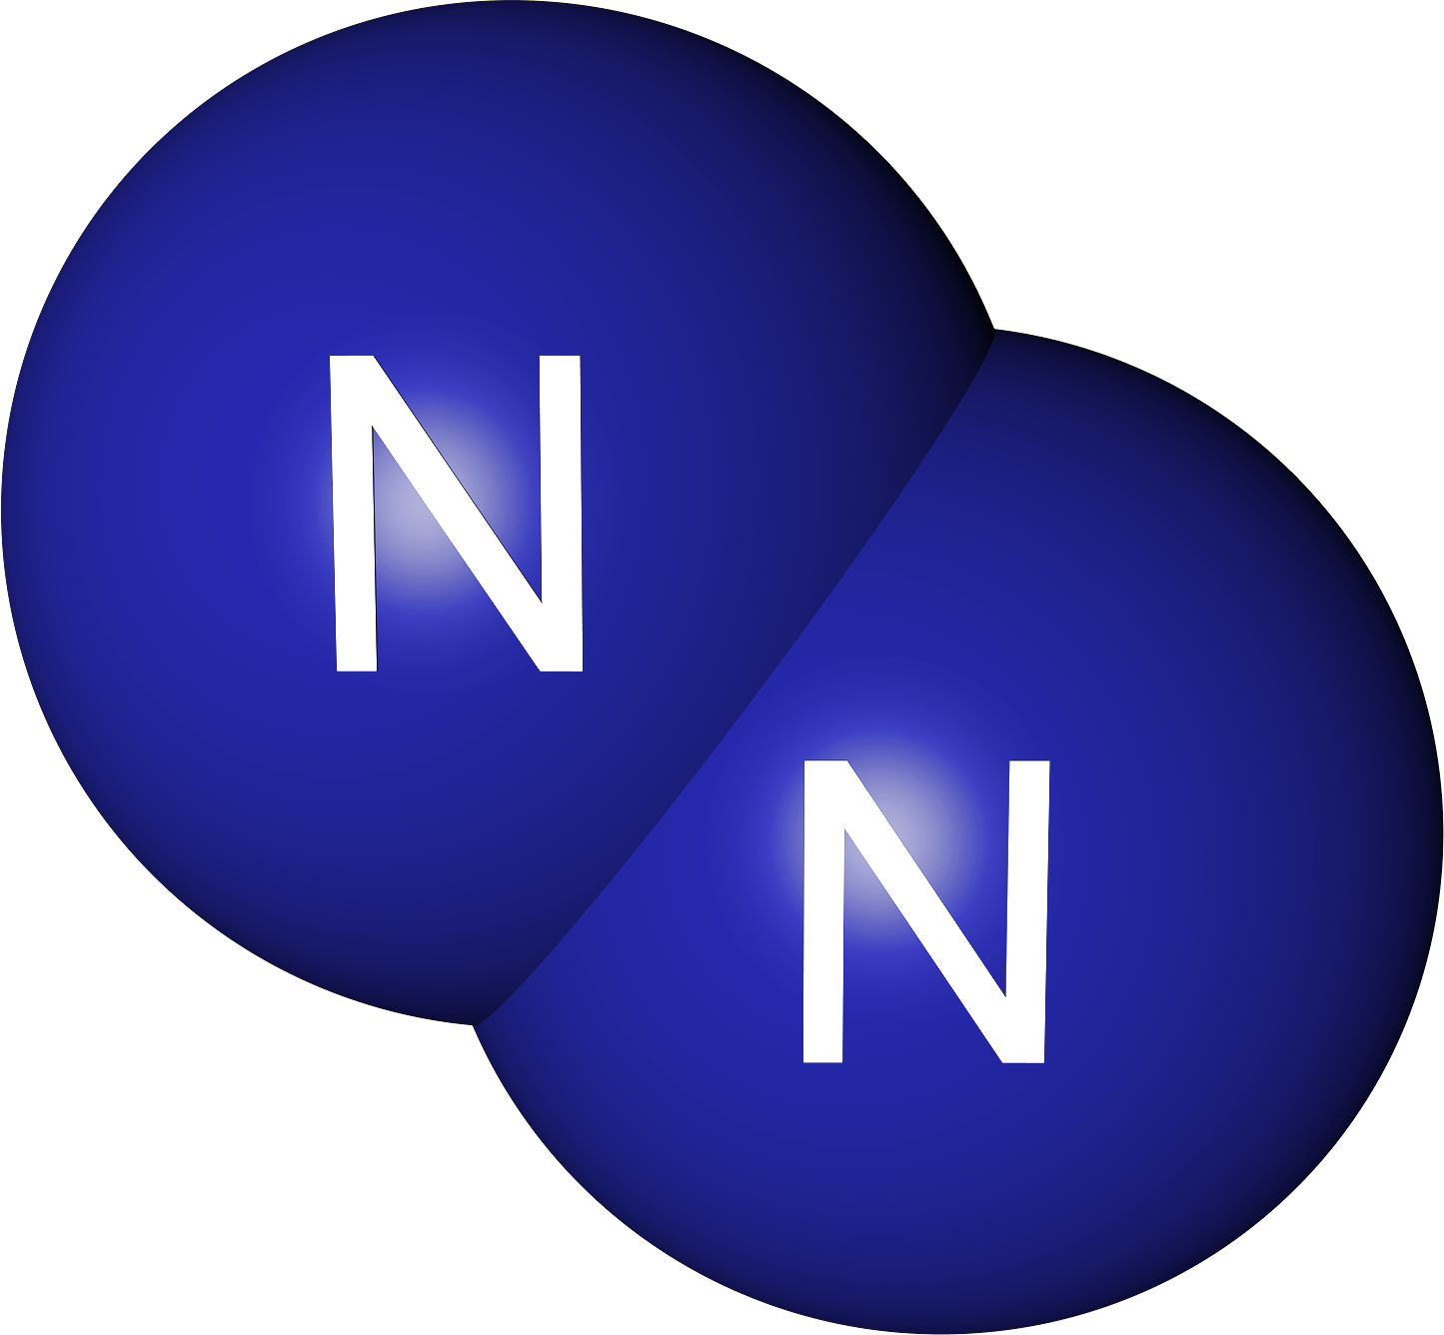
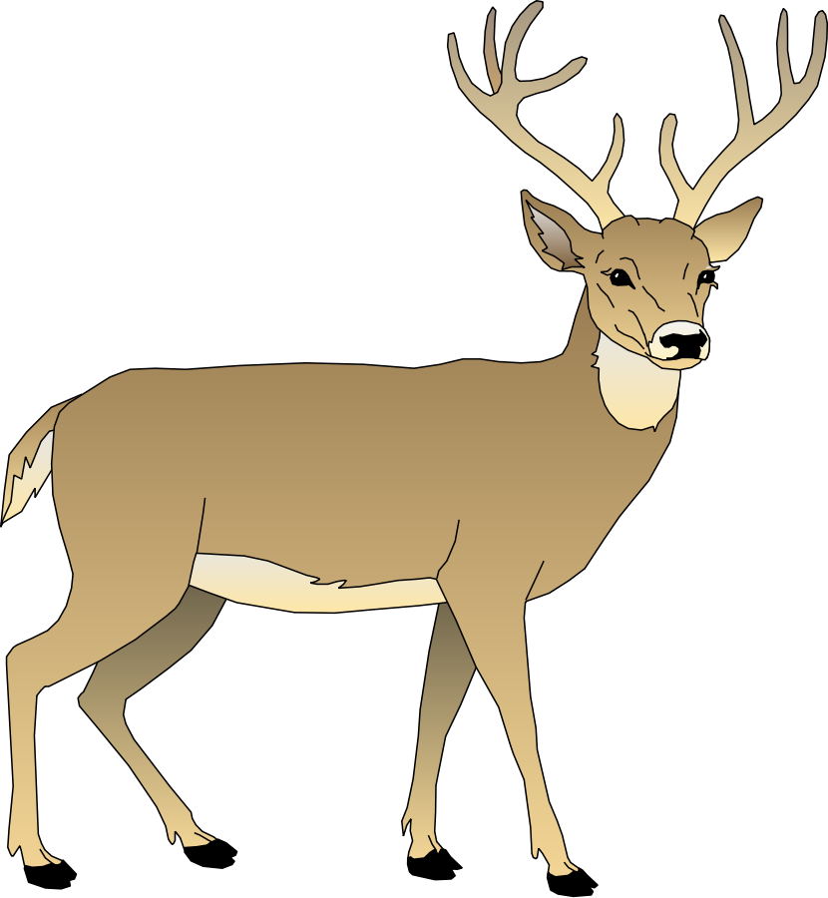
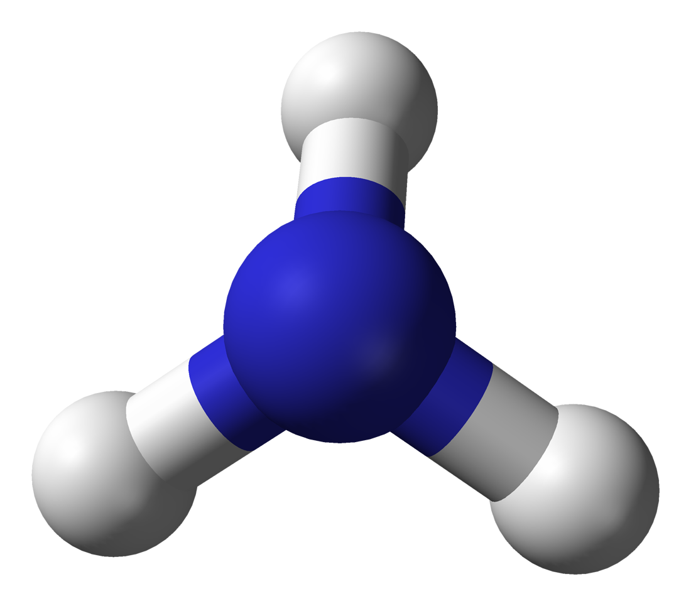
Nitrogen Fixation Review (Return to Classroom)
Nitrogen exists in the atmosphere in an unusable form, similar to the dirty water or the flour.
Like the water and flour, the nitrogen must be changed before the plant can use it.
Nitrogen in atmosphere
Animal proteins
Plant proteins
Decaying matter and waste
Bacteria “fix” nitrogen for plants
Notes:
Return to Classroom to continue PowerPoint presentation

Slide 16
Nitrogen is an essential nutrient for plants
Like us, plants need certain things to survive, grow, and thrive.
ex) water, food/nutrients, light
One of these nutrients is nitrogen, which is required by all living things.
https://slideplayer.com/slide/14156587/

Slide 17
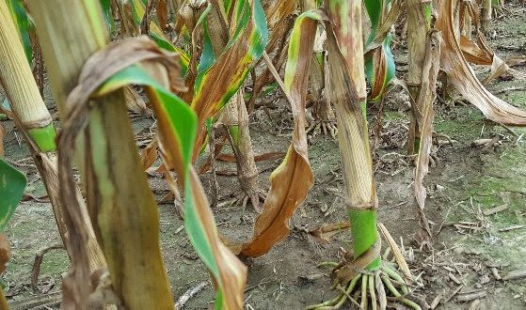
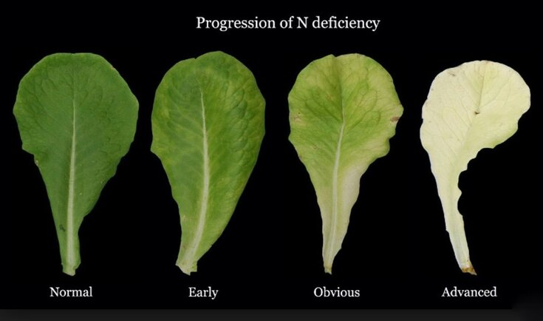
Nitrogen is fertilizer
What does nitrogen do for the plants?
Nitrogen is an important component of proteins.
In plants, these proteins are found in leaves, healthy stalks, seeds, and fruit.
Corn plant deficient in nitrogen
Notes:
Images show how nitrogen is essential for healthy plants
If there is not enough nitrogen, the plants will look different and not be as nutritious to eat

Slide 18
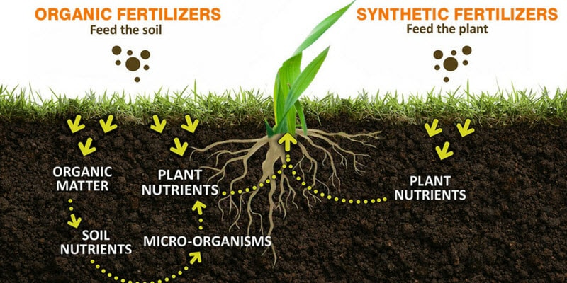
Nitrogen is fertilizer
Nitrogen is fertilizer, a substance that provides nutrients to the plant.
The fertilizer can be from plants, from animals (manure), or synthetic (made from petroleum).

Slide 19
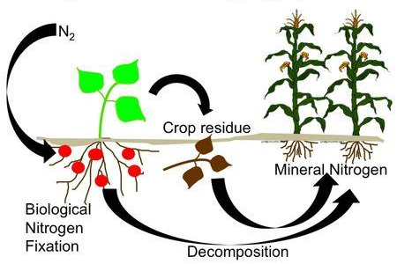
What’s so special about legumes?
When legumes die and break down, all of the nitrogen they have in their proteins (leaves, stem, roots, etc.) is returned to the soil.
This nitrogen is ready to be used by other plants!
https://eorganic.org/node/4439
Notes:
This makes legumes an important plant to have in gardens or on farms because they replenish the nitrogen in the soil
Legumes are a kind of natural fertilizer

Slide 20
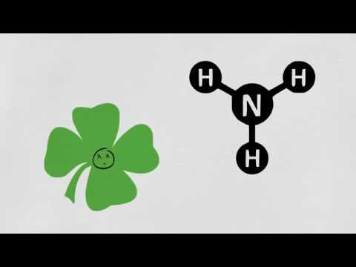
Legumes and Nitrogen Fixation Video

Slide 21
Video Recap
Where does nitrogen fixation take place in legumes?
What is the role of bacteria in nitrogen fixation? (Hint: Think during the plant’s life and after it dies!)
Any general questions or comments?

Slide 22
Now a game...
In your groups, answer the following questions:
What are root nodules?
How do legumes contribute nitrogen to the soil?
What are some examples of legumes?

Slide 23
Now a game...
In your groups, answer the following questions:
What are root nodules?
Root nodules are growths found on the roots of legumes and contain nitrogen-fixing bacteria.
How do legumes contribute nitrogen to the soil?
What are some examples of legumes?

Slide 24
Now a game...
In your groups, answer the following questions:
What are root nodules?
Root nodules are found on the roots of legumes and contain nitrogen-fixing bacteria.
How do legumes contribute nitrogen to the soil?
Legumes have a lot of root nodules and are able to fix a lot of nitrogen. When they die and break down, the nitrogen in the legume is added to the soil.
What are some examples of legumes?

Slide 25
Now a game...
In your groups, answer the following questions:
What are root nodules?
Root nodules are found on the roots of legumes and contain nitrogen-fixing bacteria.
How do legumes contribute nitrogen to the soil?
Legumes have a lot of root nodules and are able to fix a lot of nitrogen. When they die and break down, the nitrogen in the legume is added to the soil.
What are some examples of legumes?
Beans, peas, and clover.

Slide 26
Sources
Nitrogen Fixation Lesson for Kids (Study.com)
Nitrogen Fixation by Legumes (New Mexico State University)
How Plants Fix Nitrogen

