Slide 1
Regenerative Farming
Seeds To Plate Lesson Plan
Notes:
Today we’re going to talk abt regenerative farming:
Objectives for this lesson:
At the end of the activity students will be able to
Describe the processes of regenerative farming
Explain the role of carbon capture in regenerative farming
Explain the difference between organic farming and regenerative farming

Slide 2
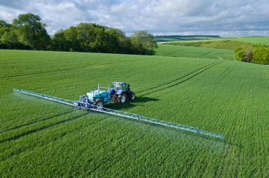
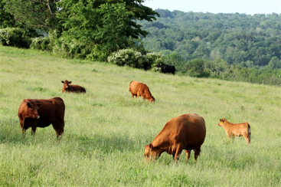
Three kinds of Farming
Conventional
Goal: profit
Organic
Goal: growing without causing harm
Regenerative
Goal: actively improving the environment
Notes:
Why are there three kinds of farming? Different goals--1. Produce as much as fast as possible to earn $, 2. Produce as much as fast as possible that is healthy food and not harm the environment or people --preventing. 3. Produce best healthy food that helps the environment and people --helping.

Slide 3
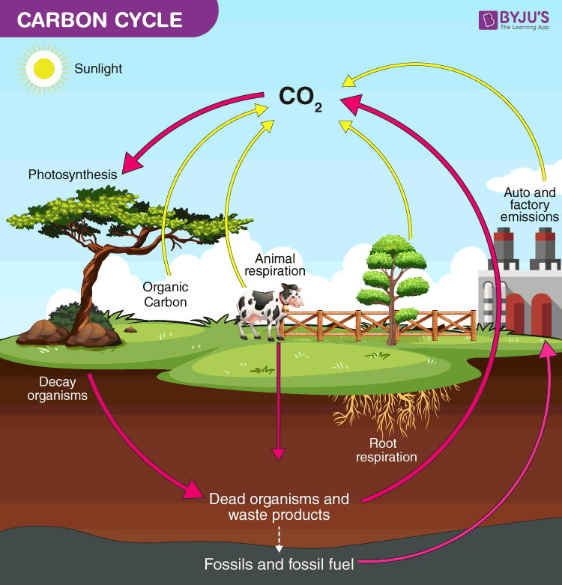
CO2 and Climate Change
What causes global warming?
What do you know about carbon dioxide in the atmosphere?
Notes:
This should be review from the lesson on carbon sequestration:
Ask students to recall if they know that farming can contribute to C02 and climate change
Ask students to discuss what they know about global warming and climate change (questions on slide)
We’re going to talk about how some types of farming increase the CO2 in the atmosphere and how some types decrease carbon emissions

Slide 4
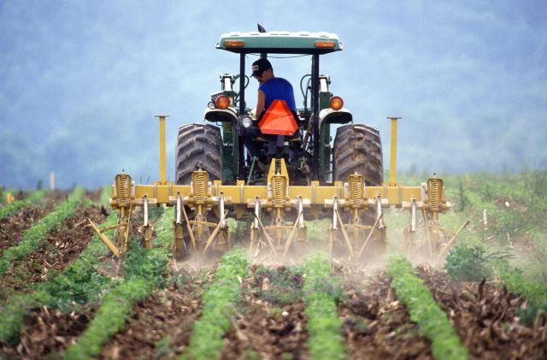
Global Warming
Burning fossil fuels (cars, airplanes)
Emissions from 3 types of Farming:
Conventional farming
Organic farming
Regenerative farming
Notes:
The arrows represent the amount of emissions each type of farming produces

Slide 5
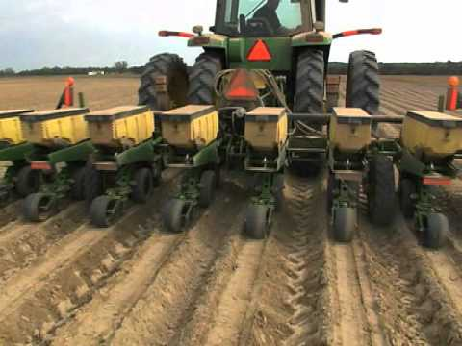
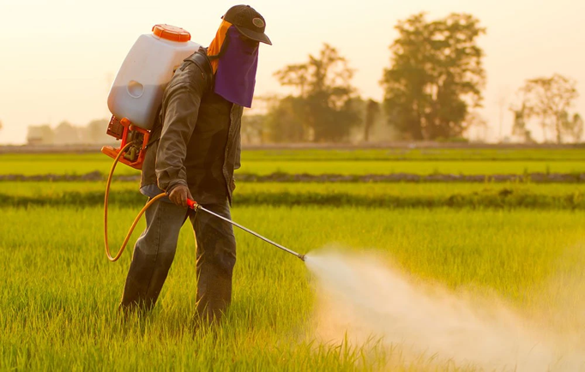
Conventional Farming
Uses tilling
Uses chemical pesticides and chemical fertilizers
Monocropping
Growing the same crop every year on the same land
Emissions from diesel fuel of tractors
Notes:
Explain the definition of tilling: digging up roots and organisms in the soil to prepare for planting
Add that tilling releases carbon from the soil into the atmosphere, adding to global warming

Slide 6
Notes:
Time stamp for video: 1:27 - 2:51
At 1:40: pause and point out how the conventional farmers are tilling the land for monocropping
You can also see here how diesel fuel is being used by the machine
At the end of the video: reiterate that this is how a majority of agriculture is produced

Slide 7
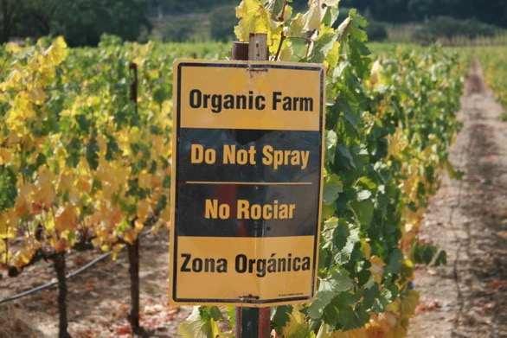
Organic Farming
Uses tilling
Relies on natural pesticides and natural fertilizers
No GMOs (genetically modified organisms)
Focuses on not using harmful chemicals

Slide 8
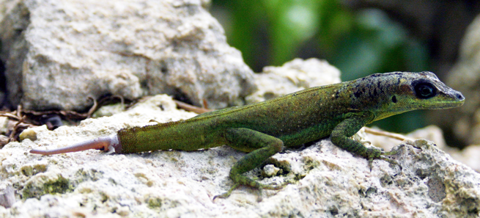
Regenerative Farming
“Re-” : again
“Generate”: produce, make
Regenerative- means able to produce again
Example:
When escaping from predators, lizards let their predators take their tail to escape
Lizards can regrow, or regenerate their tails

Slide 9
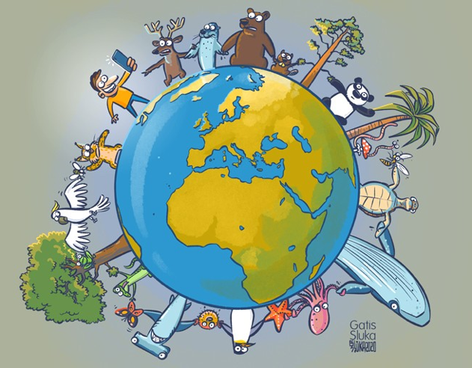
Regenerative Farming cont.
Practices no-till farming
Relies on natural pesticides and fertilizers
Crop Rotation techniques
No GMOs
Focuses on maintaining biodiversity
Notes:
Explain more about the idea of biodiversity:
It is the variety of life in a community or garden and their relationships with each other
For example: the bees pollinate the flowers, the plants provide food for the birds and squirrels

Slide 10
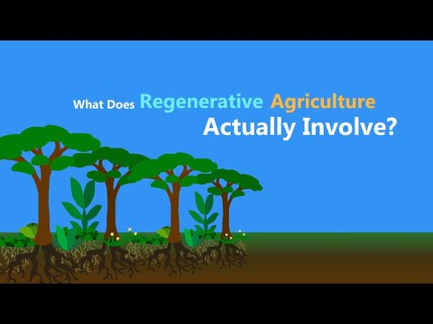
Notes:
Pause at 1:25 to make sure students understand no-till farming
Can explain how there are many organisms and roots inside the soil, keeping it together. Tilling (like using rakes or shovels) messes up this structure, making the plants in the soil less able to absorb nutrients and water.
Pause at 2:10 and make sure students understand what overgrazing does to the pasture
If cows eat the grass faster than it grows, there won’t be enough grass left
Pause at 2:36 and point out how the cows are being rotated so the grass and soil have a chance to grow
At the end of the video: emphasize that like organic farming, regenerative farming doesn’t use pesticides or chemical fertilizers, but it focuses on restoring the biodiversity in the area using carbon capture.

Slide 11
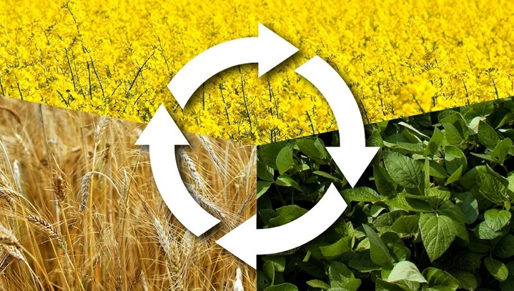
The Three Sisters
https://www.youtube.com/watch?v=FwaNH6khB0k
Mayan Farming Practice planted 3 crops together:
Corn, pole beans, squash
They help each other grow
Beans fix nitrogen into soil, needed by corn and squash
Corn structure lets beans climb
Squash creates moist soil, prickly vines prevent pests
Benefits:
Farmer does not need to use fertilizer or pesticides
Does not damage the soil
Notes:
Questions to ask the kids before this slide:
Did you know regenerative farming practices aren’t a new? The ancient Mayans used a method of companion planting called the three sisters.

Slide 12
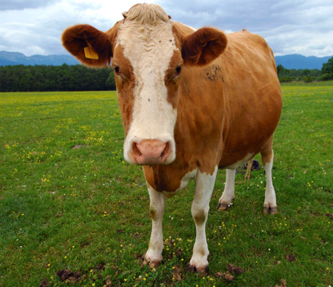
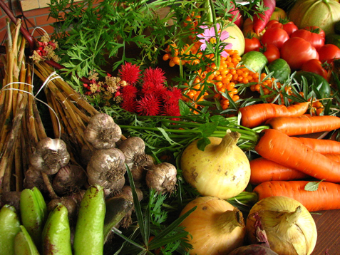
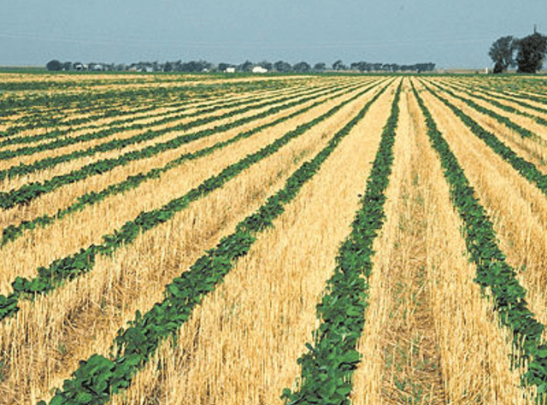
Learning Activity (5 min)
Fill out this table in groups of 3-4
https://docs.google.com/document/d/1mywBHYqivcGICZ_3tpej6hOPw7qy9GipPUzBwmDl3CU/edit?usp=sharing

Slide 13
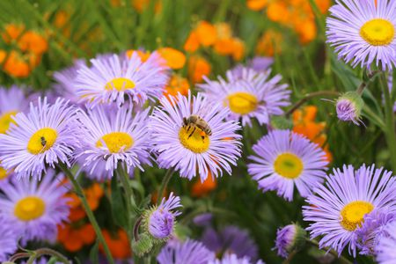
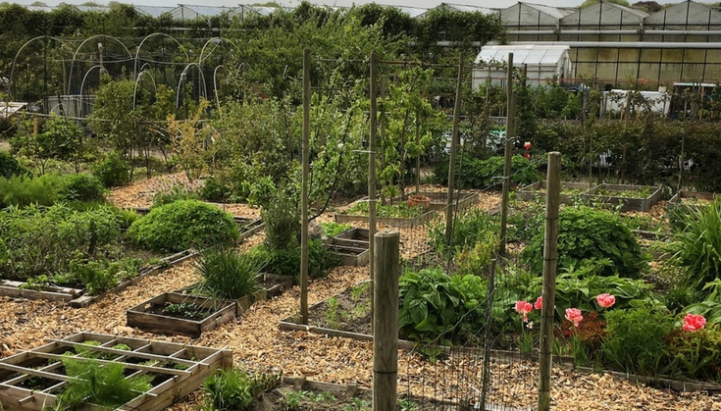
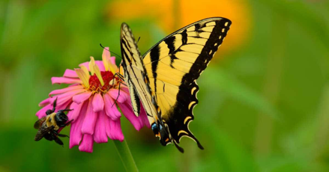
Any ideas on how to use Regenerative Agriculture in the garden?
Notes:
Observe the processes of regenerative farming in this photo:
Companion planting in the first photo: plants are grown alongside each other to benefit and give nutrients to each other
Observe pollinators like the bee and the butterfly, promoting biodiversity in the garden

Slide 14
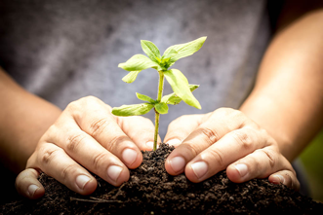
Outdoor Activity (15 min)
Observe three sisters in the garden: corn, beans, squash
See a sample of soil with roots branching out
till farming would cut off these roots.
Find an animal in the garden that is participating in regenerative farming. (example: worm, bee, butterfly)
Prepare a bed using regenerative techniques
Leave roots in and disturbing soil as little as possible

Slide 15
Reflection Question
Assessment Questions
What are some ways you think regenerative farming can reduce carbon emissions and benefit the environment in general?
What is the goal of regenerative farming?
Use chemical pesticides to mass produce crops
Actively maintain biodiversity in the farm using
sustainable methods
Use solely natural farming techniques to ensure the
health of consumers
What are the definitions of companion planting, tilling, and biodiversity?
Notes:
Answers:
Some examples may be: preserves C02 in the ground to be used by crops, uses crop rotation techniques to prevent excess use of fertilizer, rotates grazers so grass is able to grow
Assessment:
b
Tilling: digging up roots and organisms in the soil to prepare for planting
Companion planting: planting different types of crops next to each other so they can all benefit from the resources
Biodiversity: variety of organisms and plants living together in the same habitat

