Slide 1
ROOTS!
They keep us stable!

Slide 2
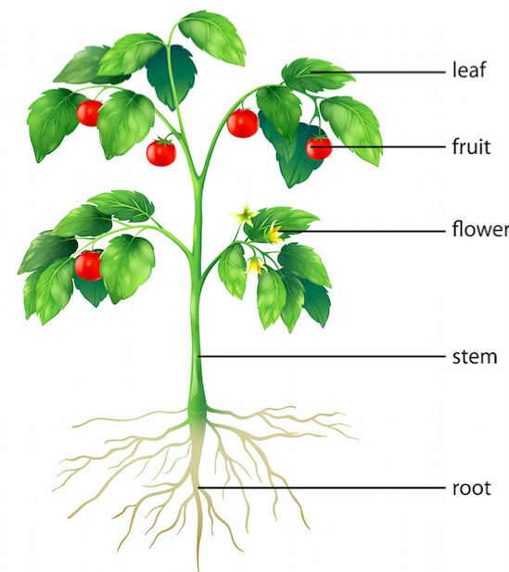
Notes:
Each part of the plant has a special function to keep the plant healthy and alive! Today, we are going to look at the functions of roots! Can someone tell me what a root is?
Roots: the portion of a plant that anchors it in the soil and takes up water, air, and nutrients for feeding the remaining parts above ground

Slide 3
Basic Function of the Roots!
Notes:
Who can tell me one basic function of a root? (type them in as students volunteer below are some for reference and be expanded on in next slides)
Usually form below the ground
Acts as an anchor for the plant
Takes in water, minerals, and nutrients from the soil through root hairs (all roots have root hairs)
Transports food and water to other parts of the plant
Stores nutrients for the plant
They improve soil structure by breaking up packed earth with their growth and holding soil in place during strong weather
As roots die, their waste breaks down into organic particles that fertilize the soil

Slide 4
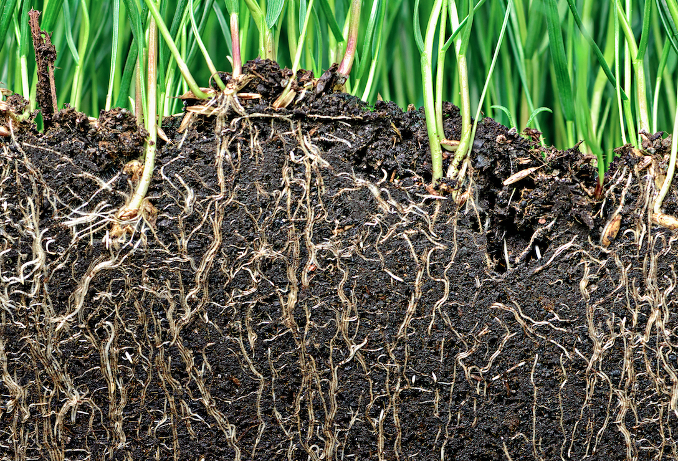
Form Below the Ground (usually)
Notes:
Only in special cases do roots form above the ground. These roots are called aerial roots.

Slide 5
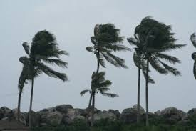
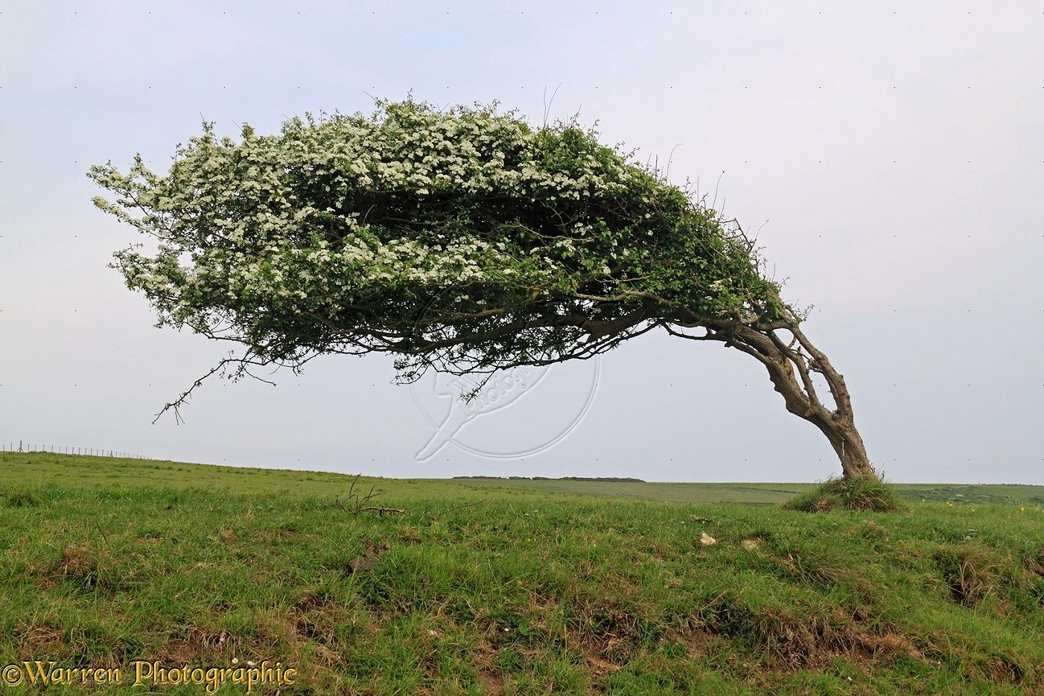
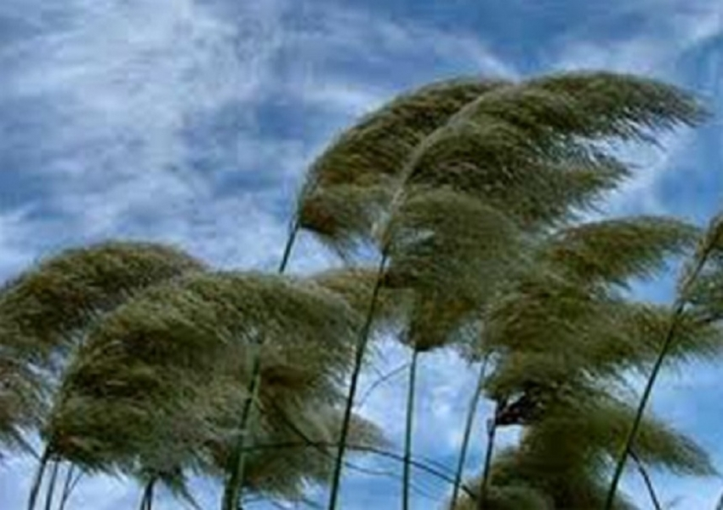
Anchor and Support
Notes:
What would happen to these plants if they didn’t have roots? That’s right, they would tip over! Roots make sure that the plant is anchored and supported.

Slide 6
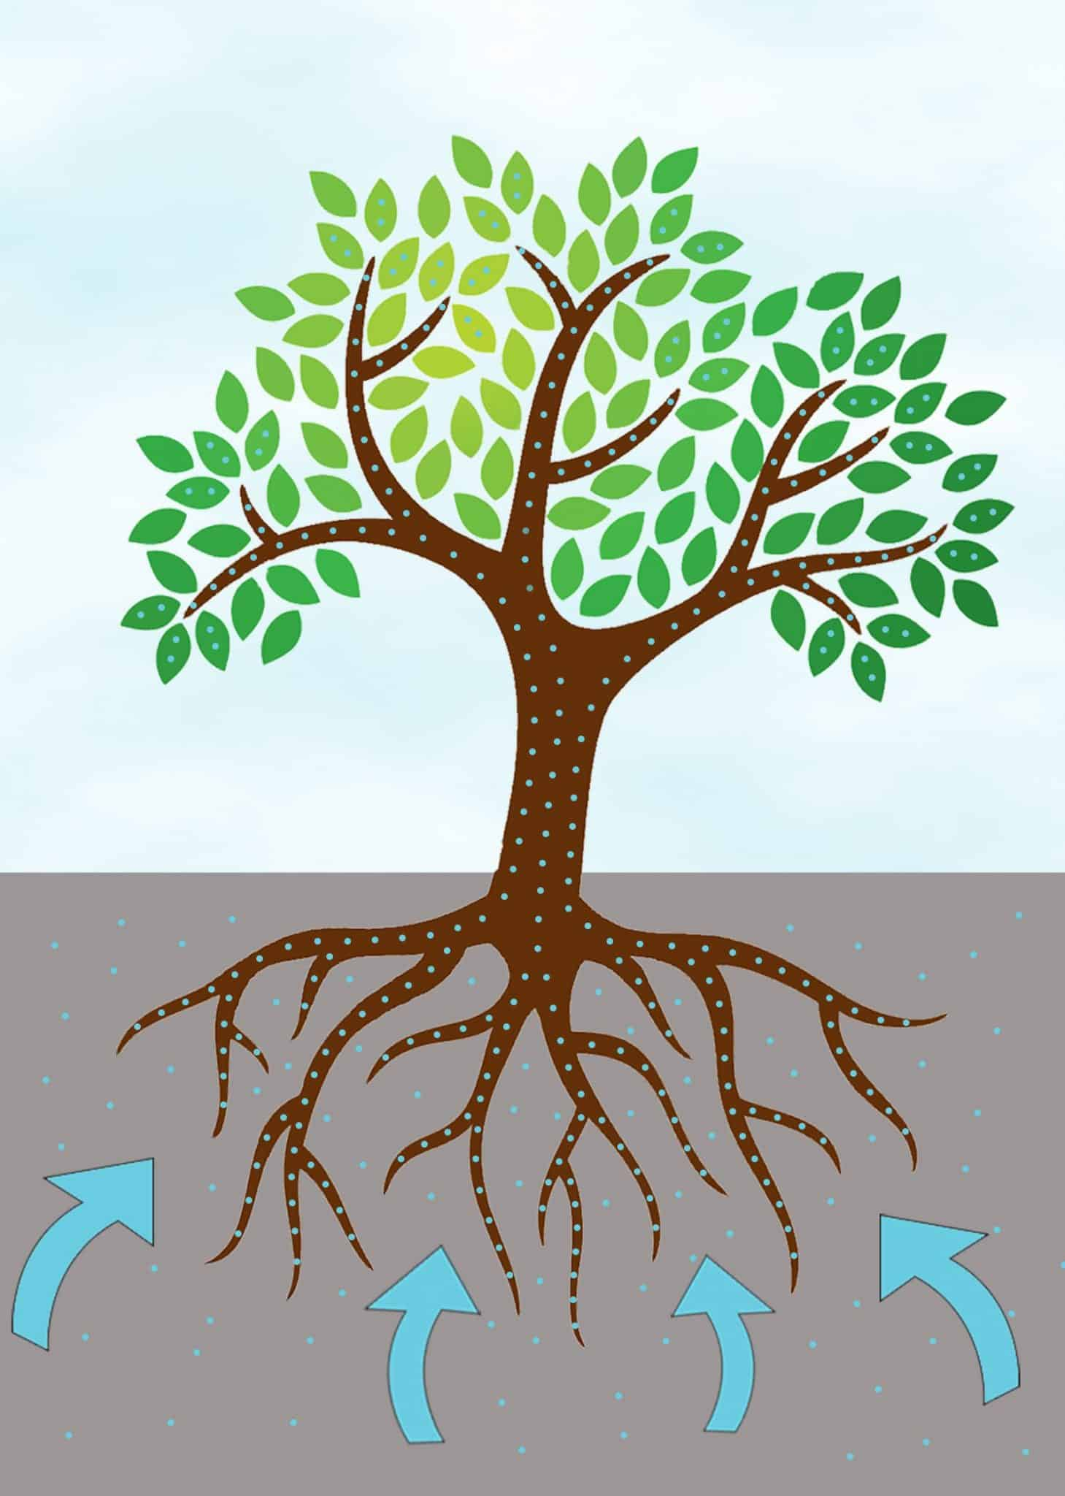
Absorb water, minerals, and nutrients from the soil through Root Hairs
Roots are the MOUTH of the plant! It is how it eats its food!
Notes:
Do you think a plant can still get its food even if it loses all of its leaves? Yes, it can through its roots! Just look at trees that lose their leaves during Fall and winter!
Root hairs: tiny, microscopic outgrowths attached to the outer layer of the main roots that help absorb water and nutrients from the soil

Slide 7
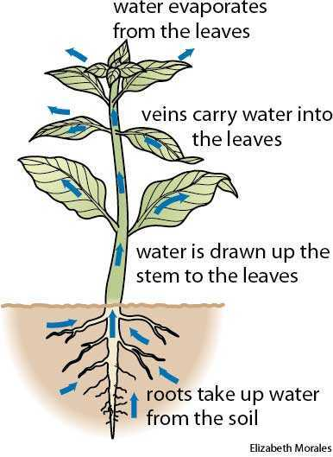
Transport Food and Water to other parts of the Plant
Notes:
Plants don’t get water and nutrients from their leaves, they get it from their roots! Roots have specially designed channels for the transport of absorbed nutrients and water to stem and leaves

Slide 8
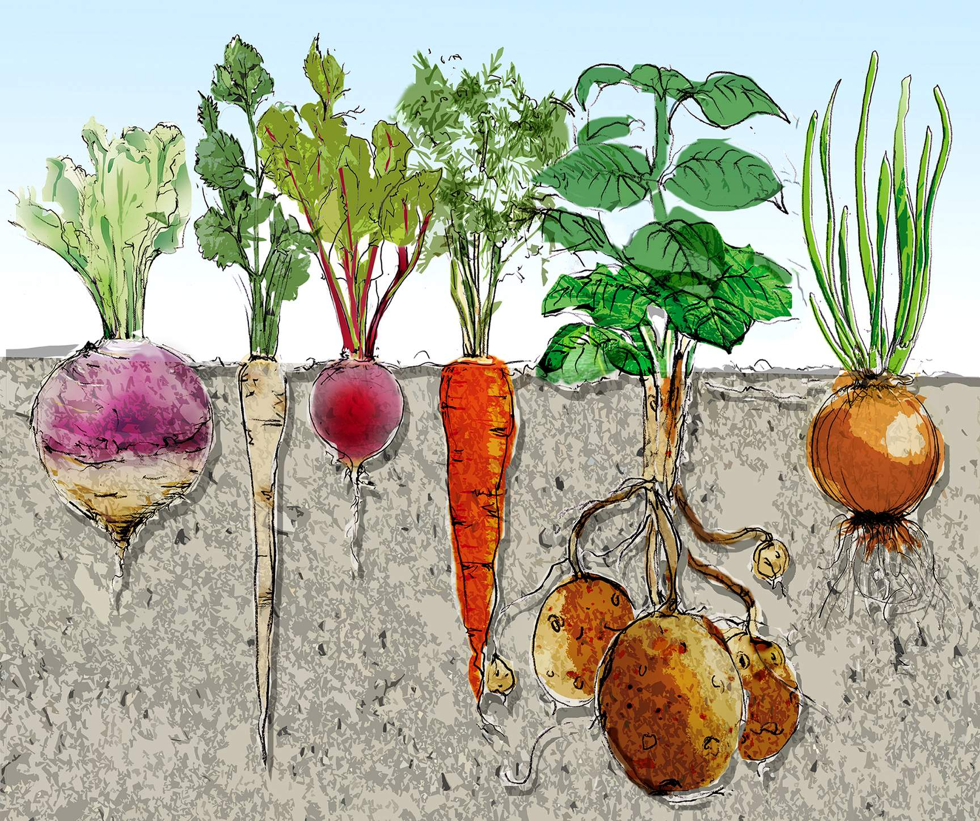
Store nutrients for the plant
Notes:
Roots can store water and nutrients in their roots!

Slide 9
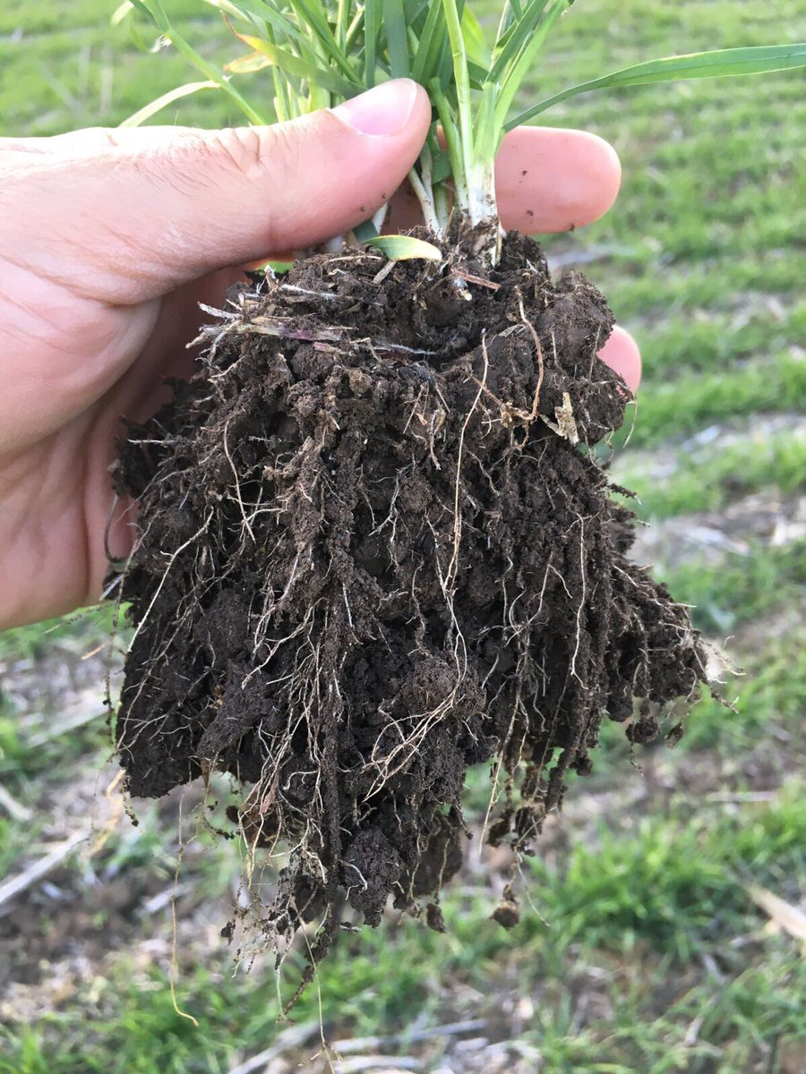
Improve Soil Structure
Notes:
They improve soil structure by breaking up packed earth with their growth and holding soil in place during strong weather

Slide 10
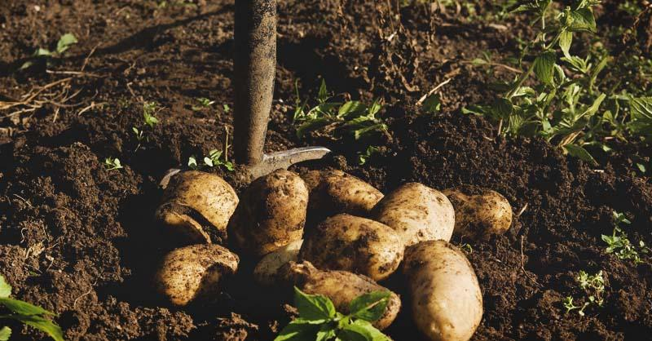
Fertilize the soil as they die and break down
Notes:
As roots die, their waste breaks down into organic particles that fertilize the soil

Slide 11
Some Roots Are Edible!
Notes:
You learned earlier before that some roots are edible! Can anyone think of any more edible roots they may have eaten?
Onion, potatoes, sweet potatoes, turnips, ginger, beets, garlic, radishes, fennel, carrots, jicama, yucca, parsnip

Slide 12
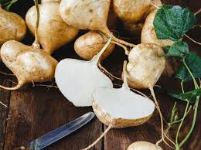
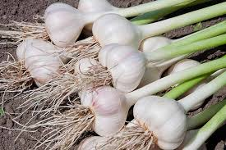
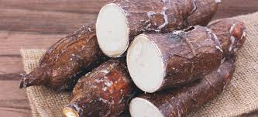
Some Roots Are Edible!
jicama
garlic
yucca
Notes:
Onion, potatoes, sweet potatoes, turnips, ginger, beets, garlic, radishes, fennel, carrots, jicama, yucca, parsnip

Slide 13
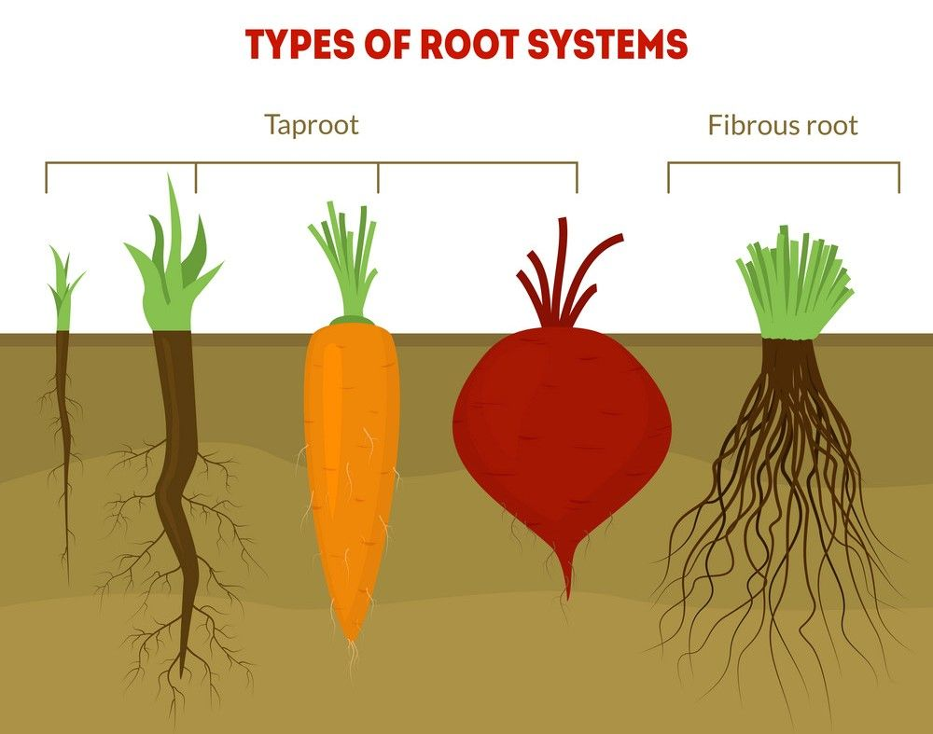
Tap Root vs. Fibrous Root
Notes:
Taproot system: a straight tapering root growing vertically downward, usually edible and found in carrots, radishes, turnips, and beets
Fibrous root system: formed by thin, moderately branching roots that grow from the stem found in grasses, ferns, and most flowering plants

Slide 14
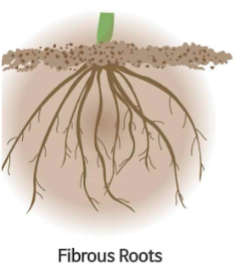
Fibrous Root
Notes:
Fibrous
Is made up of multiple root systems in a cluster – All of the roots look the same and grow at one spot
There is no primary root – Roots are thin, hairlike and grow in all directions

Slide 15
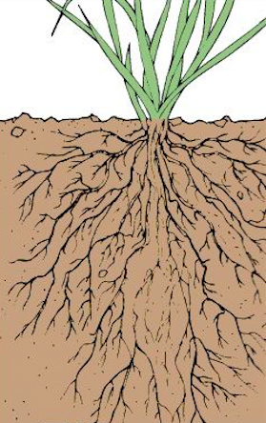
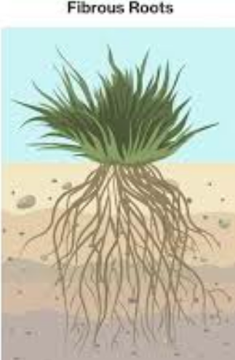
Fibrous Root
Notes:
Fibrous
Fast-growing and short life span
Usually shallow and can be either underground or above ground
Cannot survive in drought – great at absorbing surface and irrigation water but will dry up easily during drought
The roots of plants living in the tundra and in grassland prairies are generally much shallower

Slide 16
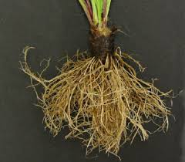
Fibrous Root
Notes:
Fibrous
They need a lot of space and can be transplanted
They need a lot of space because the roots grow in various directions and reach as far as they can
They are transferable to allow for more space if needed
Rip off white roots
Tickle the roots
Examples: onion, grass, wheat, potatoes, herbs

Slide 17
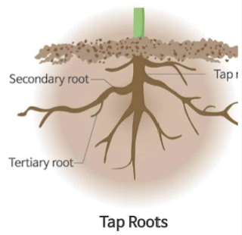
Tap Root
Notes:
Taproot
Is made up of one long and main root – as you can see from the diagram, the primary, secondary, tertiary and rootlets are visible
Roots are very thick and grow vertically

Slide 18
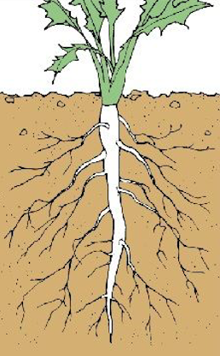
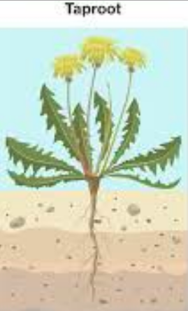
Tap Root
Notes:
Taproot
Slow growing and long life span
Deep-rooted and always underground – Better anchoring system
Can survive in the drought area due to deep roots
Plants living in dry environments often have deep roots systems so they can access water far below the surface
They can store food reserves making them self-sufficient and resilient

Slide 19
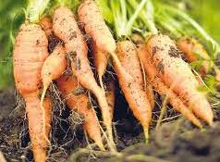
Tap Root
Notes:
Tap root
These roots cannot be transplanted, or else they will die
If these roots are taken out of the ground, they can’t be put back because they won’t grow after being uprooted
Taproots evolved over time to adjust to the environment
Most trees start at taproot and then grow roots outward to reach more water
Examples: carrots, beets, turnips, radishes

Slide 20
GARDEN TIME!

Slide 21
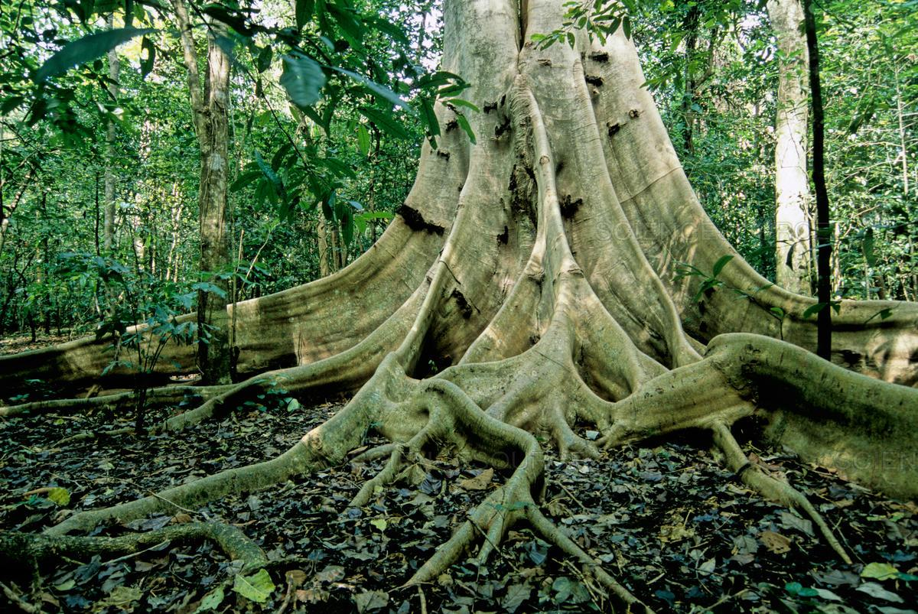
Fun Facts About Roots
Not all root structures exist underground. These roots are called aerial roots.
Buttress roots
(Ficus)

Slide 22
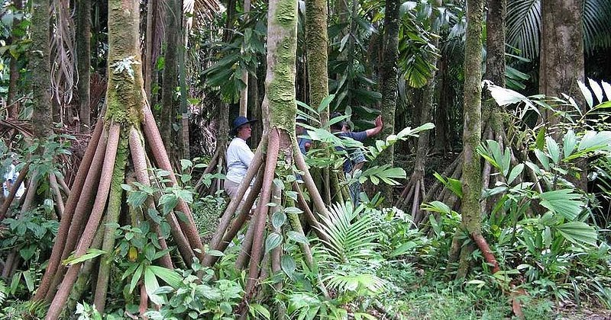
Fun Facts About Roots
Not all root structures exist underground. These roots are called aerial roots.
Stilt roots
(Walking Palm)

Slide 23
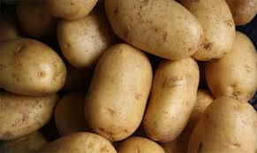
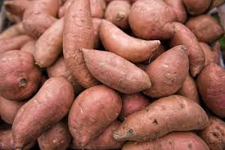
Fun Facts About Roots
Both tuber crops, the potato, and the sweet potato were listed as one of the ten most important crops in the world.
Notes:
They provide starch (an essential part of the diet), are an excellent source of fiber, are rich in Vitamin C, and are easily grown in almost any habitat.
Tuber: the short, thickened, fleshy part of an underground stem, which can grow new shoots – potatoes

Slide 24
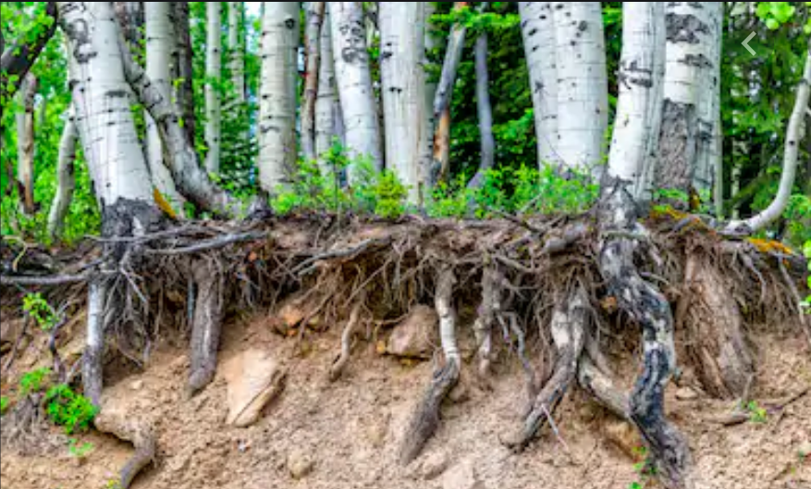
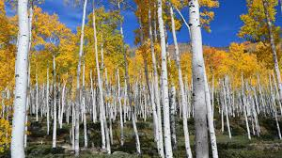
Fun Facts About Roots
The Plant with the largest root system is believed to be the Quaking Aspen which is also known as the “Trembling Giant”!
Notes:
Aspens are a clonal species with all stems connected together by a single, massive, underground root system.

Slide 25
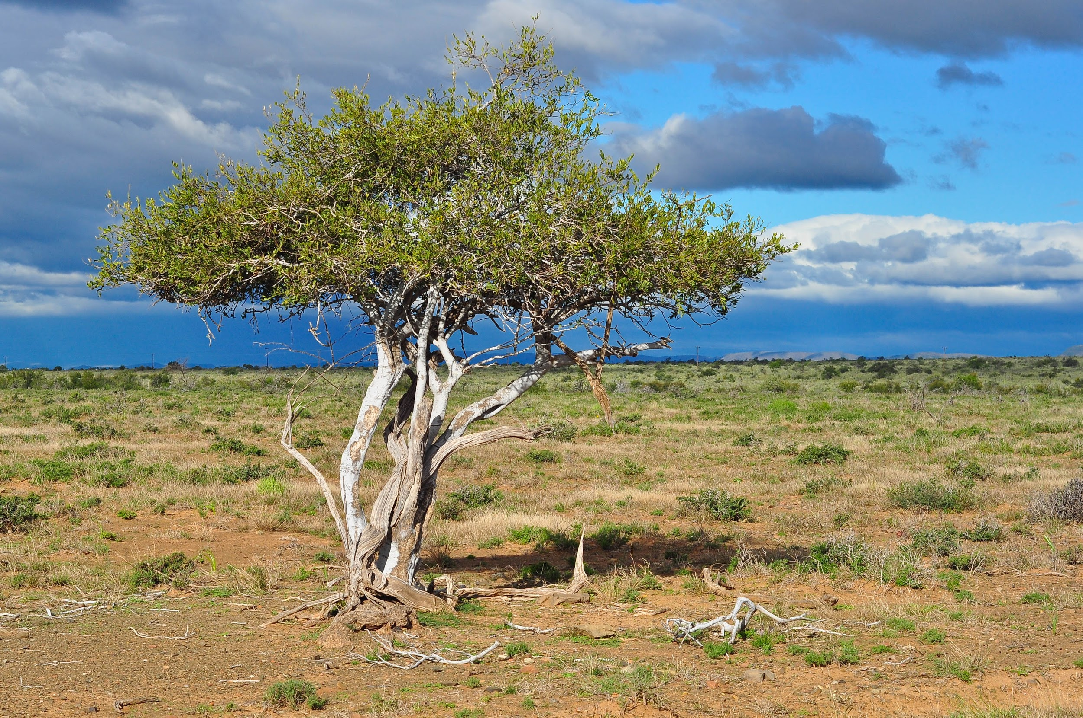
Fun Facts About Roots
The Plant with the deepest root system is a specimen of Boscia albitrunca (Shepherd’s tree) which is found in South Africa.
Notes:
Can anyone guess how deep their roots grow? They were found to have roots extending downward to a distance of 223 ft., but there are probably deeper ones out there.

Slide 26
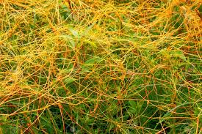
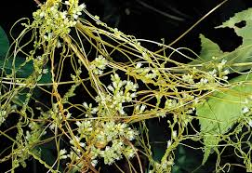
Fun Facts About Roots
Some plants have learned how to survive without roots!
Notes:
Members of the genus Cuscuta (dodder) are parasites that attach to the stems of other plants and extend tendrils (haustoria) into their host to extract sustenance. Once established, any root system it may have had upon germination withers away.

Slide 27
Fun Facts About Roots
Plants can communicate with each other through their roots!
https://youtu.be/yWOqeyPIVRo

