Slide 1
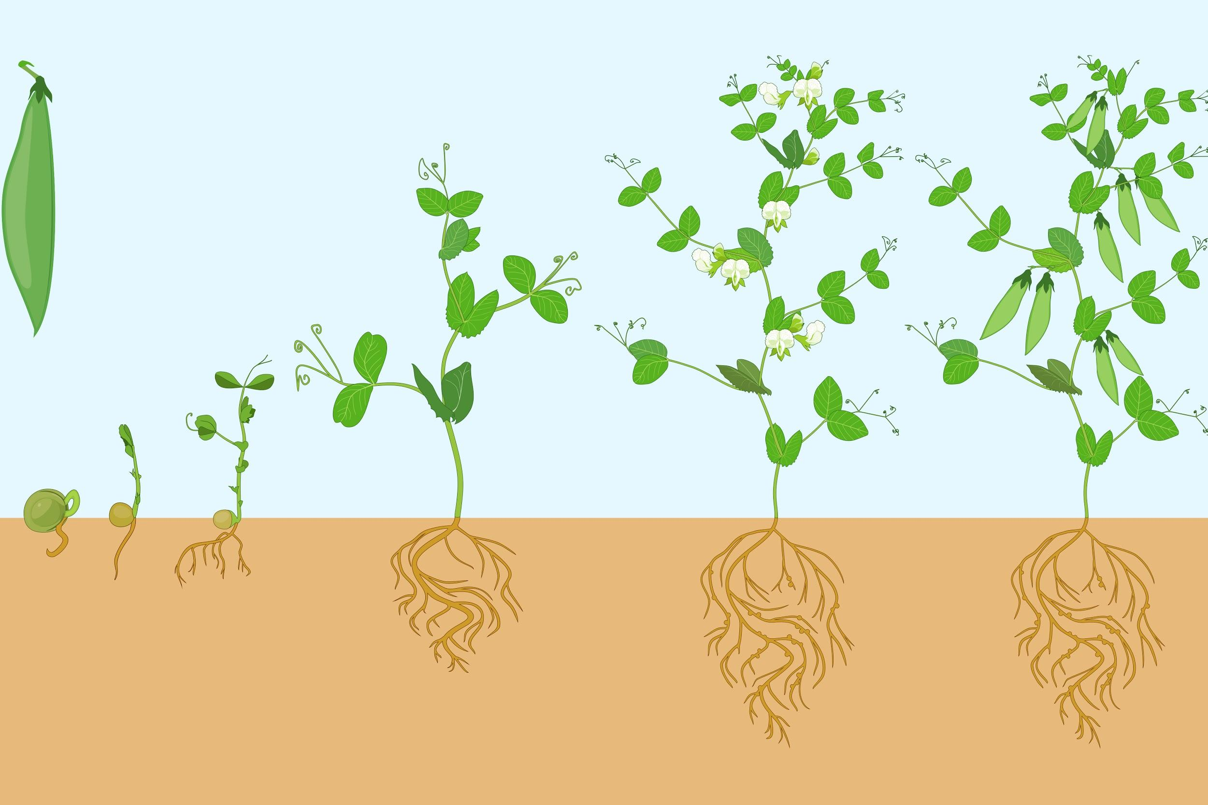
The Nitrogen Cycle
Source: https://garden.lovetoknow.com/image/252305~bean-cycle.jpg
Notes:
OVERVIEW:
Students will learn that nitrogen fixation is a crucial step in the nitrogen cycle that provides plants with an essential nutrient they need to grow. This is possible because of nitrogen-fixing bacteria, along with other bacteria in the soil, that convert atmospheric nitrogen into a form the plant can use.

Slide 2
OBJECTIVES:
After this lesson, students will be able to:
Detail the general steps of the nitrogen cycle and nitrogen fixation.
Describe the symbiotic relationship between nitrogen-fixing bacteria and plants.
ASSESSMENTS:
During this lesson, students will:
Learn about the nitrogen cycle.
Focus on nitrogen fixation as a crucial step in the cycling of nitrogen through the biosphere.

Slide 3
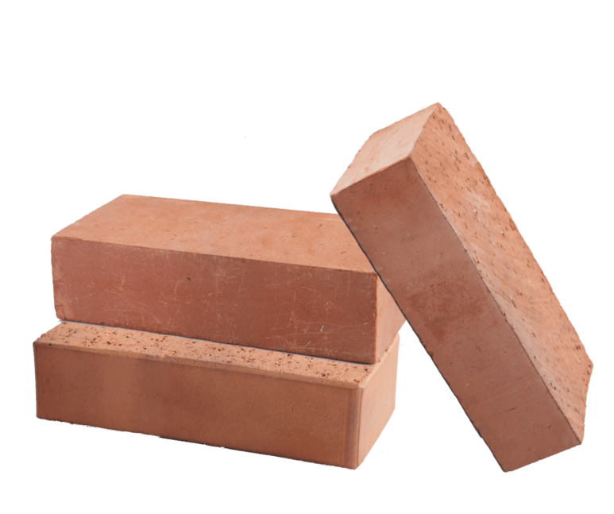
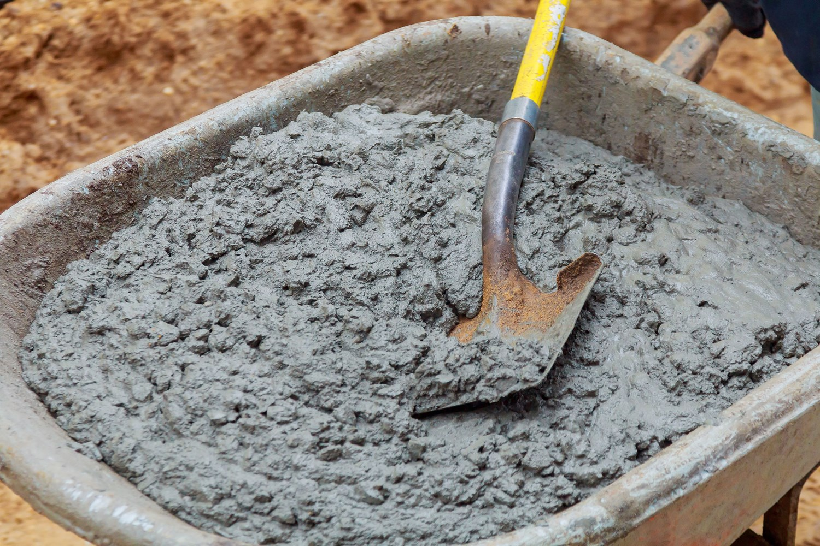
Warm-Up (5 minutes)
We’re going to build a house to go into a brand new neighborhood!
Here are the rules:
Each group has access to one resource and the supply is limitless.
Your resource is different from your neighbor’s resource.
In 2 minutes, draw what your house will look like and discuss how you’ll get your materials.
Notes:
Break students up into 4 or 5 groups. Tell the class that we are going to build a house to go into a brand new neighborhood.

Slide 4
Warm-Up
Share your houses!
What obstacles did you encounter?
Did anyone trade some of their resource for another group’s resource?
Everyone lives in the same neighborhood, so everyone would have benefitted.
This type of relationship is called symbiosis.
It occurs in nature, between many different organisms.
Notes:
Many organisms live in the same “neighborhood” and provide something to other organisms in exchange for something else.
If some groups only used the resource they were given, ask why they didn’t trade some of their resources with another group.
Explain that trading would have been the best option since everyone is in the same neighborhood, and everyone would have benefitted.

Slide 5
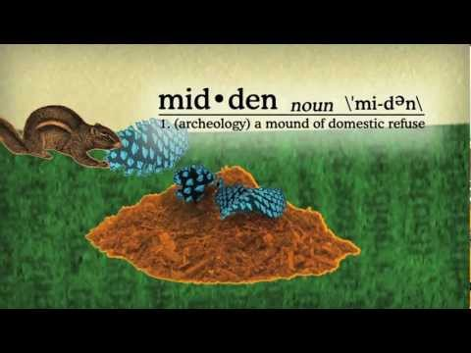
Symbiosis
Notes:
https://youtu.be/2AM3ARs9MMg
Ask: What is the symbiotic relationship in the video?
Answer: The Clark’s nutcracker (bird) and the whitebark pine (tree).
Ask: What do the two organisms provide the other with?
Answer: The bird carries the trees seeds, and the tree provides seeds for the bird.

Slide 6
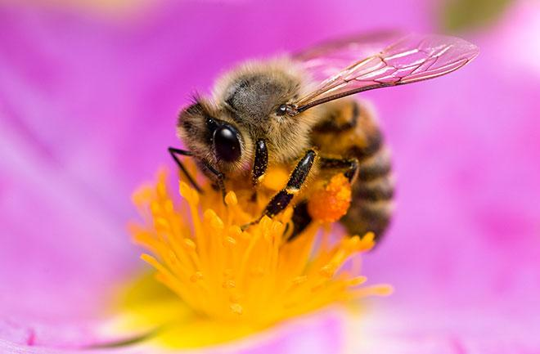
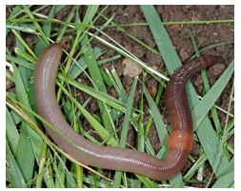
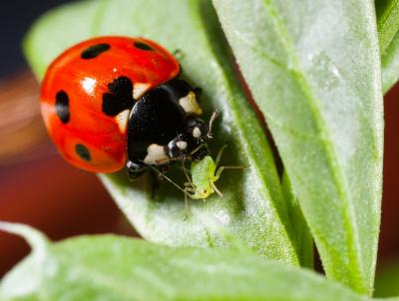
Garden Activity (15 minutes)
In groups, go out into the garden and find 3 symbiotic relationships.
Write them down. (10 minutes)
Your relationships should be different from everyone else’s.
Come back to the large group and share. (3 minutes)
https://visittemperatedeciduous.weebly.com/symbiotic-relationships.html
https://nhpbs.org/natureworks/nwep11b.htm
https://mtgarfieldgreenhouse.wordpress.com/tag/how-to-keep-ladybugs-around/
Notes:
Break the class into small groups and go out into the garden. In those small groups, have students observe and identify 3 symbiotic relationships in the garden.
These are some examples:
Bees and flowers: bees pollinate flowers and receive nectar in return
Worms and soil: worms are natural tillers in the soil and receive nutrients from the soil
Ladybugs and plants: ladybugs eat aphids (pests that eat the leaves of plants) and the plants attract aphids for the ladybugs to eat

Slide 7
Why nitrogen?
Nitrogen is a fundamental building block of proteins and nucleic acids, making it an essential nutrient.
Nitrogen is also important for the production of chlorophyll, which plants need for photosynthesis.
Nitrogen can be found in the atmosphere, in living organisms, in soil, and in the ocean.
Nitrogen is recycled through the biosphere in a process called the nitrogen cycle.
Notes:
Go back into the classroom to continue the lesson.

Slide 8
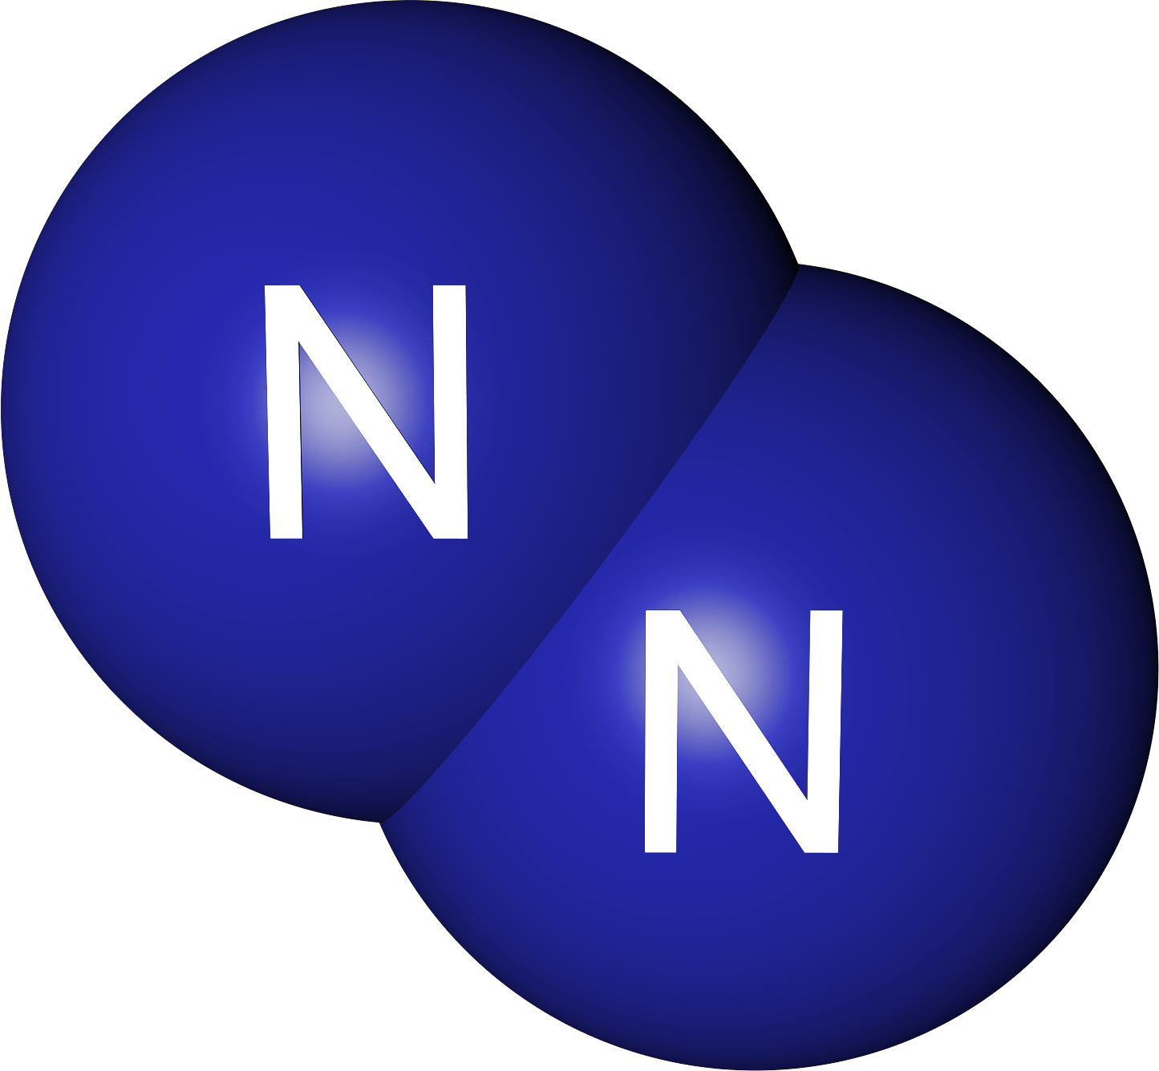
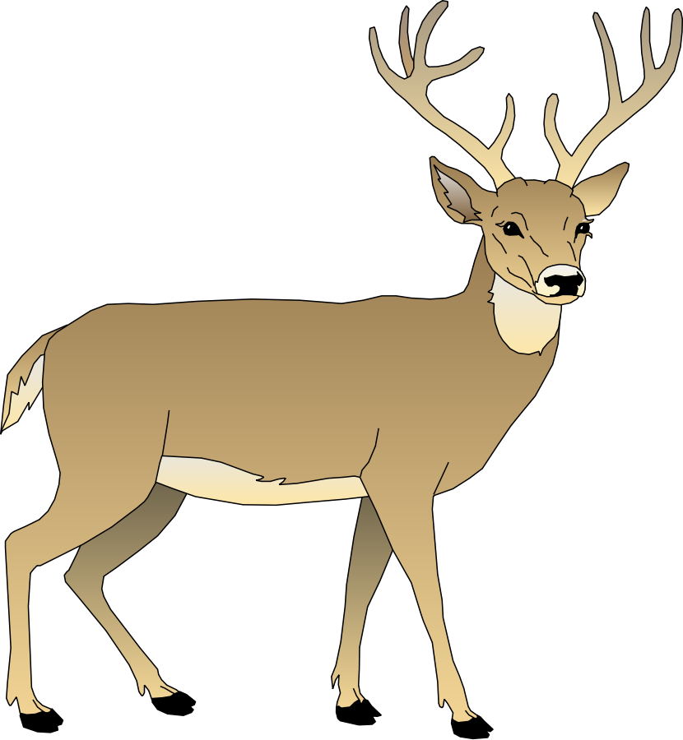
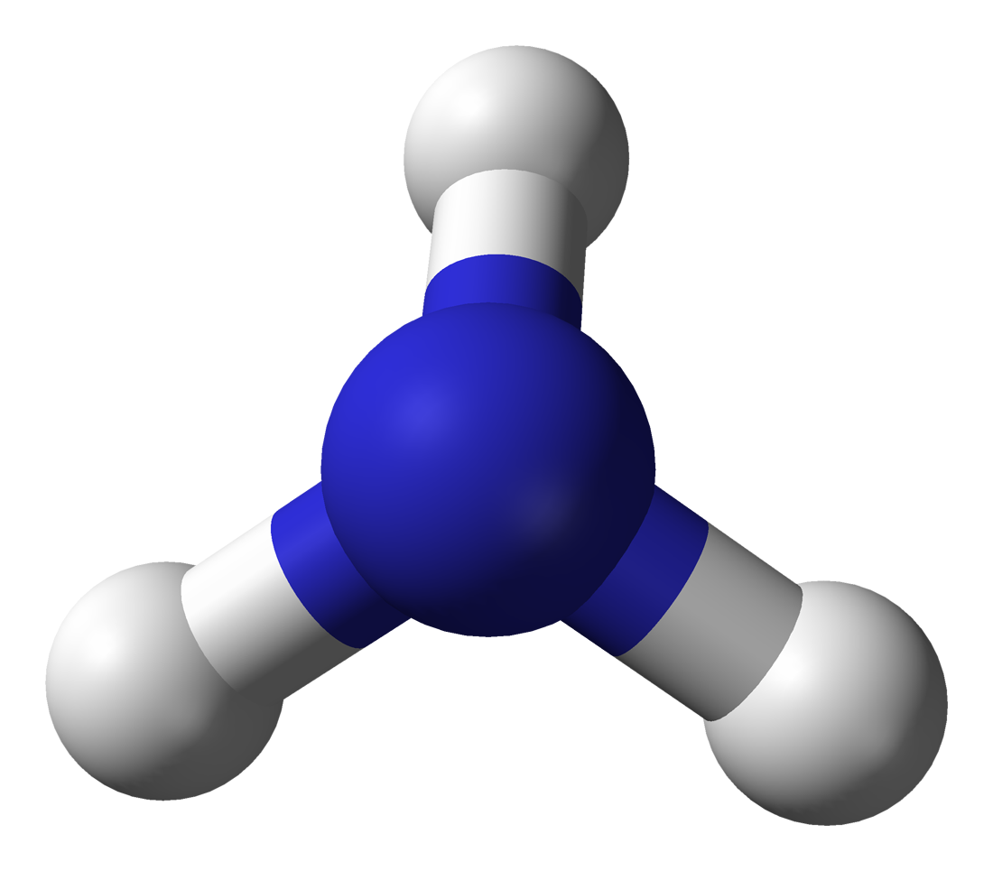
Nitrogen Cycle (5 minutes)
Nitrogen in atmosphere
Animal proteins
Plant proteins
Decaying matter and waste
Bacteria “fix” nitrogen for plants
Notes:
Overview the steps of the nitrogen cycle.

Slide 9
Nitrogen Cycle
Nitrogen in atmosphere
Animal proteins
Plant proteins
Decaying matter and waste
Bacteria “fix” nitrogen for plants
Notes:
Nitrogen is abundant in the atmosphere, but cannot be used directly by plants or animals in this form.

Slide 10
Nitrogen Cycle
Nitrogen in atmosphere
Animal proteins
Plant proteins
Decaying matter and waste
Bacteria “fix” nitrogen for plants
Notes:
In the soil, bacteria take in the atmospheric nitrogen and convert it into a form that plants can use.

Slide 11
Nitrogen Cycle
Nitrogen in atmosphere
Animal proteins
Plant proteins
Decaying matter and waste
Bacteria “fix” nitrogen for plants
Notes:
Plants can then take up the nitrogen from the bacteria and make their own proteins. Proteins make up plant leaves, stems, and roots, as well as other structures important for their survival.
If animals eat the plant, then they get all of the nitrogen stored in the plant. The animals will use the plant proteins to make their own proteins.
Any animals that eat other animals will get the nitrogen. It’s like a domino effect!

Slide 12
Nitrogen Cycle
Nitrogen in atmosphere
Animal proteins
Plant proteins
Decaying matter and waste
Bacteria “fix” nitrogen for plants
Notes:
Decomposers in the soil will break down dead animals and plants. This changes nitrogen back into its atmospheric form.

Slide 13
Nitrogen Cycle
Nitrogen in atmosphere
Animal proteins
Plant proteins
Decaying matter and waste
Bacteria “fix” nitrogen for plants
Notes:
From the decomposers, nitrogen will be returned to the air, ready to begin the cycle again.

Slide 14
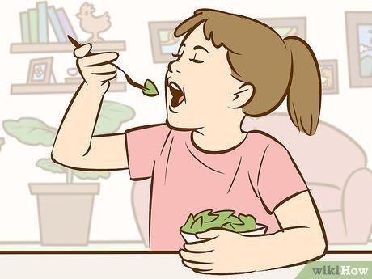
Why do we need the nitrogen cycle?
Everything needs nitrogen to live.
Atmospheric nitrogen is abundant (It exists in the air)
However, we cannot use nitrogen in this form.

Slide 15
Why do we need the nitrogen cycle?
Nitrogen must go through a cycle before being incorporated into plants.
When we eat plants, we get nitrogen!

Slide 16
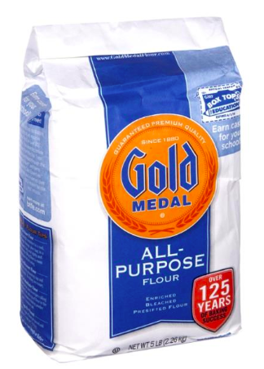
Let’s bake some bread...
Nitrogen is like flour. You can’t eat flour and get the nutrients out of it as if you had eaten a slice of bread. You need to make it edible.

Slide 17
Let’s bake some bread...
First, you would have to add water and yeast to the flour and mix.
This is similar to what happens in the soil when bacteria convert atmospheric nitrogen into another form.

Slide 18
Nitrogen Cycle
Nitrogen in atmosphere
Animal proteins
Plant proteins
Decaying matter and waste
Bacteria “fix” nitrogen for plants

Slide 19
Let’s bake some bread...
Then, you put the dough in the oven to bake into bread.
This is similar to plants converting nitrogen into a form useful to their growth.
Notes:
refer to chart. Maybe replace the bottom row with the chart

Slide 20
Nitrogen Cycle
Nitrogen in atmosphere
Animal proteins
Plant proteins
Decaying matter and waste
Bacteria “fix” nitrogen for plants

Slide 21
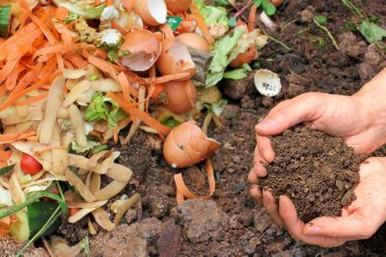
Let’s bake some bread...
If you were to add leftover bread to a compost pile, which gets added back to the soil, it could be used to grow wheat. Then, you could make more flour and the cycle would repeat!

Slide 22
Nitrogen Cycle
Nitrogen in atmosphere
Animal proteins
Plant proteins
Decaying matter and waste
Bacteria “fix” nitrogen for plants

Slide 23
Nitrogen Cycle
Nitrogen in atmosphere
Animal proteins
Plant proteins
Decaying matter and waste
Bacteria “fix” nitrogen for plants

Slide 24
Now a recap
http://studyjams.scholastic.com/studyjams/jams/science/ecosystems/nitrogen-cycle.htm
Notes:
Ask: Where does nitrogen go in the cycle (general, basic overview; can ask one student for the first step, another student for the next step, etc)?
Answer: Nitrogen from the atmosphere (air) goes into the soil to bacteria. From there, the bacteria change the nitrogen into a form that the plants take up. Then, animals can eat the plants. Plants and animals break down and bacteria convert the nitrogen they have into nitrogen that goes back into the atmosphere.

Slide 25
An Important Step in The Cycle: Nitrogen Fixation
Nitrogen in atmosphere
Animal proteins
Plant proteins
Decaying matter and waste
Bacteria “fix” nitrogen for plants
Notes:
Highlight nitrogen fixation as a crucial step in the nitrogen cycle and bacteria as key players in the process.

Slide 26
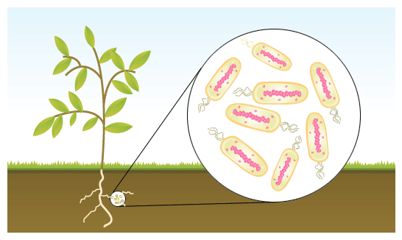
Nitrogen Fixation and Bacteria
Bacteria are microscopic organisms that can sometimes be harmful, but they can also be helpful.
Bacteria in the soil convert atmospheric nitrogen into a form plants can use.
They are called nitrogen-fixing bacteria.
Bacteria are like a filter that the nitrogen must pass through before it can be used by the plant.
https://www.clipart.email/clipart/nitrogen-fixing-bacteria-clipart-299480.html
Notes:
Explain there are bacteria and organisms in the soil that help the plant. Bacteria are microscopic organisms that can sometimes be harmful, but they can also be helpful.

Slide 27
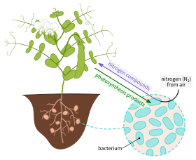
Why would bacteria help the plant?
In return for the nitrogen, the plant provides protection and nutrients to the bacteria.
This is an example of symbiosis!
The bacteria are usually close to the plant roots in the soil.
Since we eat plants and animals to get nitrogen, nitrogen fixation is essential for our survival.
https://en.wikipedia.org/wiki/Root_nodule

Slide 28
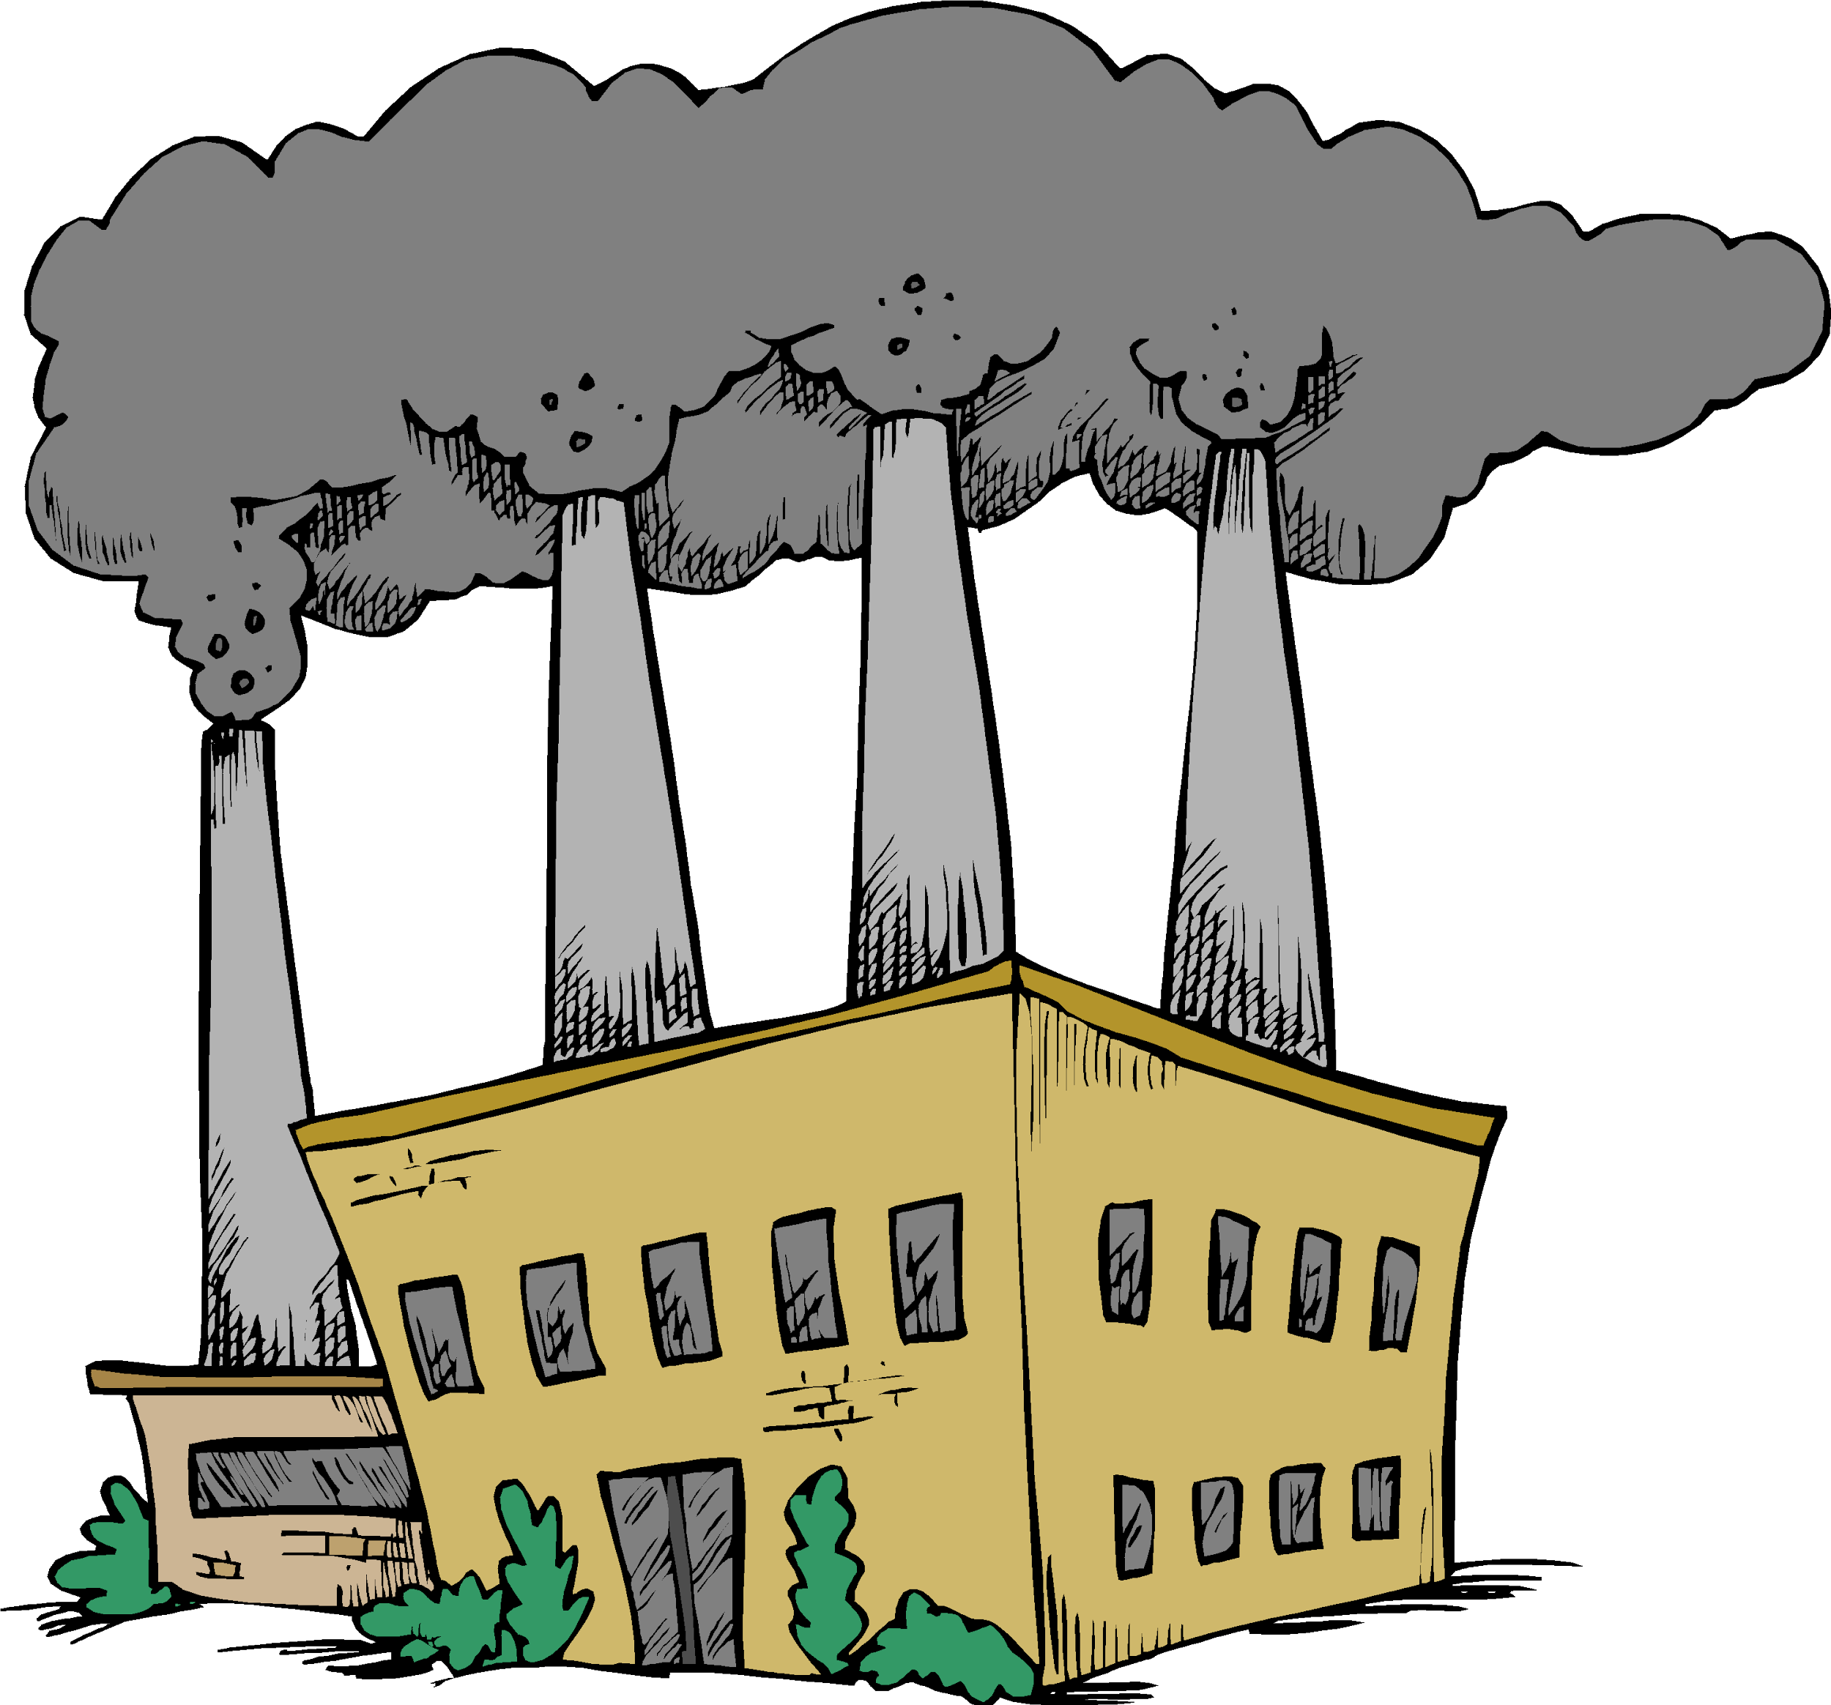
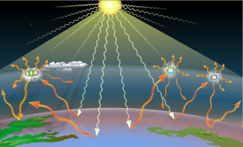
Human activities affect the nitrogen cycle
Burning fossil fuels contributes nitrogen to the atmosphere, resulting in:
Rainfall that harms lakes and forests (acid rain).
Increased greenhouse gases, contributing to global warming.
https://www.thoughtco.com/acid-rain-overview-and-prevention-3878348
https://www.clipartmax.com/download/m2i8i8N4H7i8i8N4_fossil-fuel-petroleum-clip-art-burning-fossil-fuels-cartoon/
https://en.wikipedia.org/wiki/Greenhouse_gas
Notes:
Have students recall the end of the nitrogen cycle video. Human activities can impact the nitrogen cycle by burning fossil fuels or using an excess of nitrogen fertilizers.

Slide 29
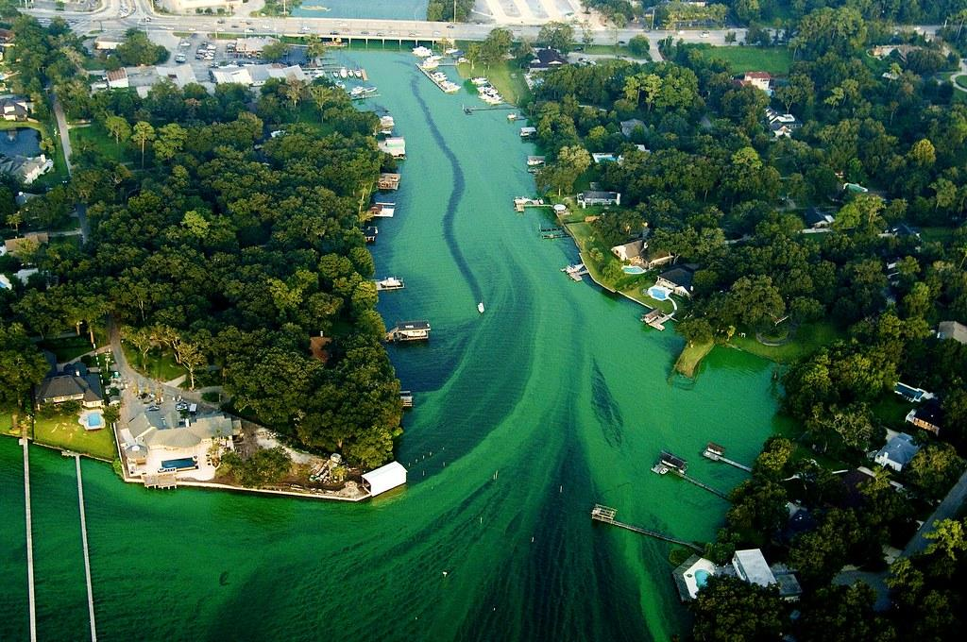
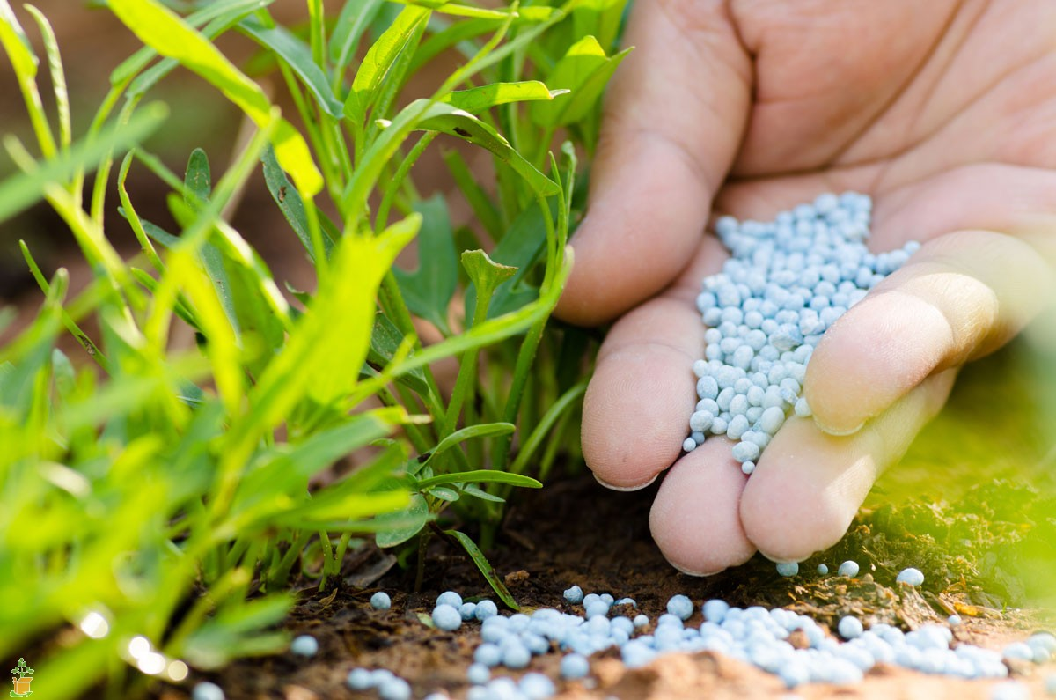
Human activities affect the nitrogen cycle
Using nitrogen fertilizers can also contribute nitrogen to the soil environment.
If there is heavy rain, the fertilizers can pollute nearby water sources!
https://floridalandscapedoctor.com/2017/01/07/why-use-a-slow-release-nitrogen-fertilizer/
https://www.flickr.com/photos/60712765@N05/5553341244

Slide 30
Sources
12.23 Nitrogen Cycle (CK-12 Foundation)
Nitrogen Fixation Lesson for Kids (Study.com)
Videos:
Symbiosis
The Nitrogen Cycle

